Slide 1
Screening, brief intervention and Referral to Treatment (SBIRT) Preview
Stephanie Peglow DO, MPH

Slide 2
Objectives
At the end of the session the participant should:
Be familiar with the basics of Screening, brief intervention and referral to Treatment

Slide 4
What is SBIRT?
“Screening, Brief Intervention, and Referral to Treatment (SBIRT) is an evidence-based practice used to identify, reduce, and prevent problematic use, abuse, and dependence on alcohol and illicit drugs. The SBIRT model was incited by an Institute of Medicine recommendation that called for community-based screening for health risk behaviors, including substance use.”

Slide 5
SBIRT
SBIRT: Screening, Brief Intervention, Referral to Treatment

Slide 6
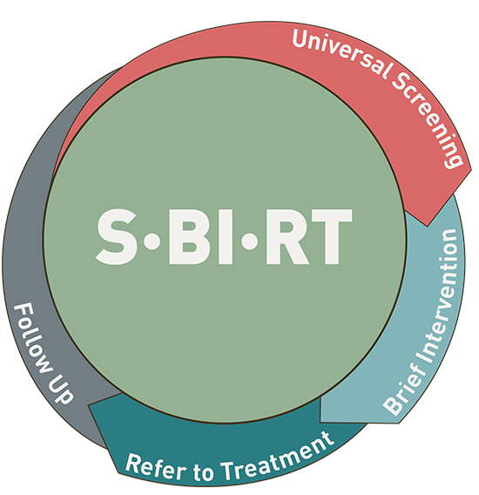
Why SBIRT?
Treatment does work
The ED/Primary care visit is an opportunity for intervention
Timely referral is effective
Practitioners are reluctant to screen and intervene without a framework
Saves Money
Improves prognosis

Slide 7
SBIRT
SBIRT is the gold standard for screening for risky alcohol and drug use
In all settings SBIRT is appropriate and can be used by nearly anyone in the healthcare field
Patients should be screened yearly
You can bill for SBIRT

Slide 8
SBIRT: Screening
Brief Screening
Initial screening for drugs and alcohol
If positive, more in depth screening for each substance

Slide 9
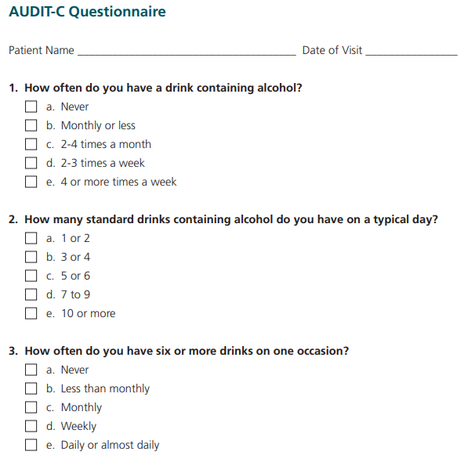
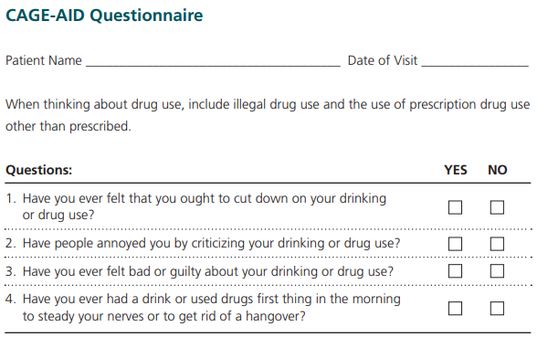
Initial screening: NIDA Quick Screen, CAGE-AID, AUDIT-C
Notes:
I prefer NIDA-Quick screen since it is an in-depth one question screener that screens for all substnaces. If the patient says “never” for all drugs in the Quick Screen, reinforce abstinence. Screening is complete. CLICK
CAGE AID is a commonly used, 5- question tool used to screen for drug and alcohol use. The CAGE Assessment is a quick questionnaire to help determine if an alcohol or drug assessment is needed. If a person answers yes to two or more questions, a complete assessment is advised. With sensitivities and specificities up to 77 and 85% respectively. CLICK
AUDIT-C is a simple 3-question screen for hazardous or harmful drinking that can stand alone or be incorporated into general health history questionnaires.

Slide 10
Initial screening
Notes:
If patient says “Yes” to one or more days of heavy drinking, note that patient is an at-risk drinker. At this point screen for alcohol use disorders with a more in depth screener. Also, please see NIAAA website “How to Help Patients Who Drink Too Much: A Clinical Approach”. This is listed in the references

Slide 11
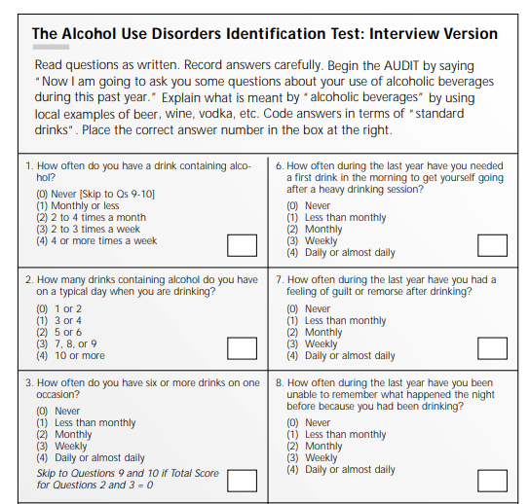
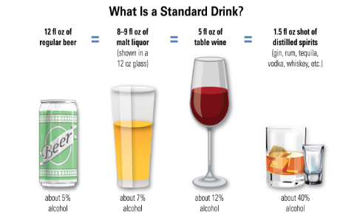
Screen for Alcohol Use Disorders: AUDIT
https://www.drugabuse.gov/sites/default/files/files/AUDIT.pdf
Notes:
AUDIT, or Alcohol Use Disorders Identification Test is a 10 item questionnaire that can be administered by a paraprofessional to screen for hazardous or harmful alcohol consumption. This screener correctly identifies 95% of people with an alcohol use disorder. The AUDIT has been used with a variety of populations and cultural groups.

Slide 12
SBIRT: Brief Intervention
Brief Negotiated Interview (BNI)
Raise the subject
Provide feedback
Enhance motivation
Negotiate and advise
https://my.ireta.org/sites/ireta.org/files/Final%20Fidelity%20Webinar%20powerpoint.pdf

Slide 13
SBIRT: Referral to Treatment
Referral to treatment:
Peer Counselors Warm Line (Norfolk 664-6683)
CSBs
In Virginia Treatment locator: https://drugfreeva.org/grab-a-lifering/
Outside of Virginia treatment locator: https://findtreatment.samhsa.gov/ or 1-800-662-HELP

Slide 14
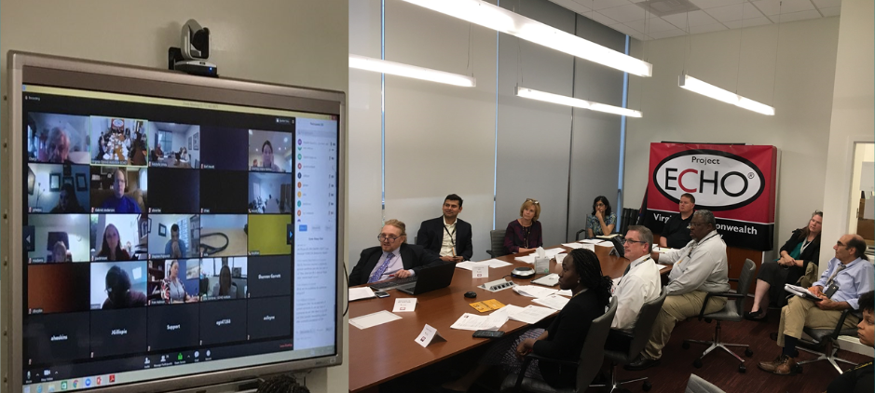
But I need more help!!
Virginia Opioid Addiction ECHO: https://www.vcuhealth.org/for-providers/education/virginia-opioid-addiction-echo/va-opioid-addiction-echo
ASAM levels of care
Need detox?
Which level of rehabilitative care?
Who needs what?
Notes:
treatment resources and determine roles of an interdisciplinary addiction team

Slide 15
Billing for your hard work!
 | Negative | Positive
Pre-screen (aka Brief Screen) | Not separately reimbursable, considered integral part of routine preventive care | Initiate full screen
Full Screening | HCAPS H0049 Potential diagnosis: Z13.9 | Positive full screen with a brief intervention and/or referral 99408 (15-30 minutes) 99409 (30+ minutes) Potential diagnosis: Z71.41, Z71.42, Z71.51, Z71.52, Z71.6

Slide 17
References:
SBIRT Oregon: https://www.sbirtoregon.org/
NIAAA Guide, how to help at risk drinkers or patients with alcohol use disorder http://pubs.niaaa.nih.gov/publications/Practitioner/CliniciansGuide2005/clinicians_guide.htm
Smoking Cessation guide for clinicians: “Helping Smokers Quit: A Guide for Clinicians” https://www.ahrq.gov/sites/default/files/wysiwyg/professionals/clinicians-providers/guidelines-recommendations/tobacco/clinicians/references/clinhlpsmkqt/clinhlpsmksqt.pdf
WHO toolkit for Tobacco Interventions https://apps.who.int/iris/bitstream/handle/10665/112835/9789241506953_eng.pdf;jsessionid=1A2207A753FC5079DBF18D53A03D37B7?sequence=1
SAMHSA toolkits for treating addictions to several substance and special populations guides https://store.samhsa.gov/

Slide 18
Instrument and Permissions to Reproduce
CDC 5 A’s resources are public domain; Maybe used in clinical practice without permissions. See https://www.cdc.gov/tobacco/campaign/tips/partners/health/materials/twyd-5a-2a-tobacco-intervention-pocket-card.pdf
NIDA quick screen and NIDA modified assist may use in clinical settings without permission; permission to use in power point permission verified 2/11/19 via email. See https://www.drugabuse.gov/sites/default/files/pdf/nmassist.pdf
AUDIT-C and AUDIT is available for use in the public domain and in clinical settings- see https://www.integration.samhsa.gov/images/res/tool_auditc.pdf and http://lib.adai.washington.edu/dbtw-wpd/exec/dbtwpub.dll?BU=http%3A//lib.adai.washington.edu/instrumentsearch.htm&TN=Instruments&CS=0&QY=find%20%28AccessNo%20ct%2032%29&RF=Full&DF=Full&MR=&NP=3&RL=0&DL=0&XC=&ID=&AC=QBE_QUERY
CRAFFT may be reproduced in its exact for in clinical settings. Special permission otherwise necessary. https://www.integration.samhsa.gov/clinical-practice/sbirt/CRAFFT_Screening_interview.pdf
CAGE-AID as produced by SAMHSA- all SAMHSA materials are free to use with reference because its public domain https://www.integration.samhsa.gov/images/res/CAGEAID.pdf
DAST can be used for non-commercial use with credit to author Harvey A Skinner see: file:///C:/Users/peglowsl/Downloads/DAST%202008%20(1).pdf

