Slide 1
Resilience and the 2nd Victim: Intersection of Race, Violence & Medicine
Brian H. Williams, MD, FACS
@BHWilliamsMD
/BrianWilliamsMD

Slide 2
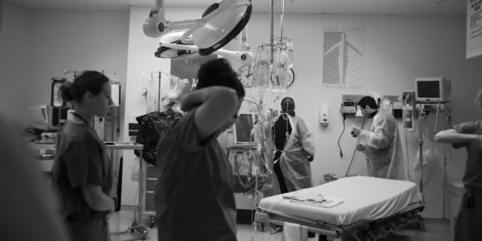
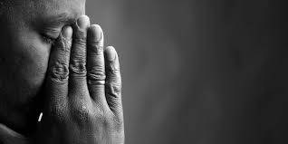
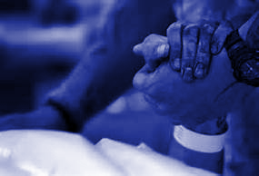
RACE VIOLENCE MEDICINE

Slide 3
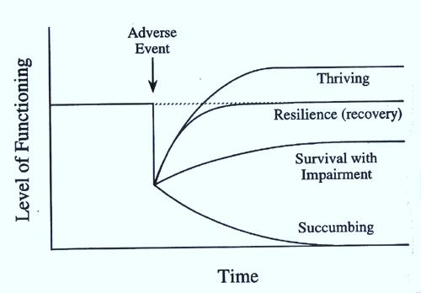
(O’Leary & Ickovics, 1994)

Slide 4
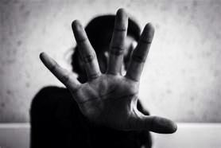
Avoidant
Ruminative
Hypervigilant

Slide 5
Resilience
Physical Self-Care
Social Support
Meaning and Purpose

