Slide 1
Building Community Through Accessible Online Spaces
Instructional Design and Technologies

Slide 2
Presentation Objectives
Describe accessibiltiy and inclusivity in online environments
Explain how to incorporate accessible and inclusive practices into your courses to build community

Slide 3
Current Understanding
Join us on mentimeter at https://www.menti.com/alpt8s5aj62o
so we can gather our prior knowledge on what we believe “accessible” means.
Notes:
Use your device to join the Mentimeter via the QR code or using the link above, which I will also drop into the chat. Using one or two words, tell us what “accessible” means to you. Within our word cloud, we will see the words that most resonate with us when it comes to accessibility. Once we get in all of the responses, we will have a brief synthesis of our current understandings of accessibility.

Slide 4
Defining Accessibility in Online Courses
In courses, legally defined as the need to afford the “same information, engage in the same interactions,” and provide equitable services to all individuals with equitable ease of use (Burgstahler, 2017)
Other considerations:
How and when students access information
Technology availability to students
Non-traditional online learners
Notes:
In online coursework, resources, and interactions, it is important to consideration the accessibility of what is being offered to students. It is not only about looking at the way the information is being offered, but how students may access it themselves. For example, do all students have reliable internet or technology access? What does their time and commitment access look like based on their living situations? These are important lenses to look through when considering accessibility of all students, but particularly those who are in online courses, as many are non-traditional students who are working full-time, likely caring for family, and have other time-consuming commitments (LNESC, 2022).
Legally, the Office of Civil Rights and US Department of Education define accessibility as providing individuals with disabilities the “opportunity to acquire the same information, engage in the same interactions, and enjoy the same services as a person without a disability in an equally effective and equally integrated manner” with an “equivalent ease of use” (Burgstahler, 2017, “The legal basis”). In online courses, all individuals should have equitable access to the same information with relative ease of use in order to obtain the information. Developing communities within an online classroom can help support those who have barriers to accessibility.

Slide 5
Defining Inclusivity in Online Courses
Accessibility and inclusivity go hand-in-hand
Inclusion is “providing equal access and opportunities to all” (Holisitic, 2021)
Creating inclusive environments is curating environments where all feel as if they belong and are supported regardless of identifiers (VDOE, 2020)
Notes:
Accessibility and inclusivity go hand and in hand. It is important to create an inclusive space within your classroom, as it extends the accessibility of your space. It will also help create the online community your students will feel safe, respected, and supported within. Inclusion itself is defined as “providing equal access and opportunities to all” (Holistic, 2021, p. 5) while inclusive communities are environments where all are “supported and are extended a sense of belonging regardless of race, ethnicity, gender, identity, learning preferences, socio-economic status or education” (VDOE, 2020, p. 10). Inclusion in online courses are those environments where every student is supported and has a sense of belonging, regardless of their identifiers.

Slide 6
What is an online community?
What is it NOT?
An online space that creates a sense of belonging for students and is based in positive interactions, collaboration, trust, and building connections (Pilcher, 2016).
An online classroom space with no curated interactions, groups of students with forced interactions, and/or a space with little or no instructor interaction.
Notes:
Maslow’s infamous hierarchy of needs theory “stresses ‘sends of belonging’ as a basic human need that must be fulfilled” before one can be successful in their academics and social life (Pilcher, 2016, p. 4). This is all the more crucial in graduate-level learning, where we see a variety of non-traditional learners who have a multitude of responsibilities outside of the classroom, and seek connection with their peers even through a busy schedule. Pilcher (2016) notes that “students who feel a strong sense of belonging have higher academic achievement, retention, and persistence” and a “sense of belonging is relational, created by frequent, positive interactions and needs to be maintained.” Those who lack this sense of belonging “suffer higher levels of mental and physical illness, are more likely to drop out of learning environments, and exhibit feelings of isolation, rejection, and exclusion” (p. 4).
An online community, therefore, is one that creates a sense of belonging for students and is based in positive interactions, collaboration, trust, and building connections. It is fostered through a “social community of learners” that collaborate based on knowledge, personal or academic goals, “possess shared expectations,” and believe that all group members matter to one another (Pilcher, p. 5). An online community is not simply a classroom of students, it is a deliberate curation of interactions that is continuously fostered within the course. Simply grouping students together and requiring them to interact will not build community. Additionally, it is important that the instructor themselves is involved in the development of the online community and considers themselves a part of the shared space. There should also be space to build community outside of the classroom.

Slide 7
Building Online Communities
Here
3 Ps: People, Purpose, Platform
Create a space for students “just to ‘be’” (Ahlquist, 2020)
Venus
“Clear connection” between online classroom community and teaching presence (Pilcher, 2016)
Mars
Notes:
One of the keys to building communities is to look at student engagement through the lens of the 3 Ps: People, Purpose, Platform. The People are the community and stakeholders you are looking to engage. When you examine these, look at the specific values, cultural backgrounds, goals, and other important background information of the people you are engaging with. The Purpose is the values, outcomes, and goals of the space you are interacting in. This will likely be based in the course you are teaching, so consider the values of the content, the outcomes of the course or program, and the specific learning goals for students. The Platform should come last, which are the tools, tactics, and strategies for engagement. Within a course, the LMS will be the primarily engagement tool, but there are secondary tools for engagement within the LMS that should be considered. Tactics and strategies for engaging students with the instructor and students with other students should also be planned. In creating these spaces, you will also need to consider creating a space for your students “just to ‘be’.” Many students are overwhelmed with the amount of notifications from emails, Zoom, social media, Blackboard, news outlets- the world has turned to virtual notification overload, and creating a space for them to interact with one another on their own time will provide them with the opportunity to connect on their own terms (Ahlquist, 2020). Finally, Pilcher states that in a review of research: “The single most influential factor in establish a sense of community in an online classroom is the instructor.” One study noted “a clear connection between perceived teaching presence and a student’s sense of community.” Vitally important is the teaching presence in creating community within the course (p. 6).

Slide 8
Communities
Join us again on mentimeter at https://www.menti.com/alpt8s5aj62o
so we can gather our current use of community building at EVMS.
Notes:
Let’s return again to mentimeter. Join using the QR code, the link, or return to the tab if you still have it open. I will also drop the link again in the chat. Describe how you build community in your courses, and we will discuss briefly before moving forward. If anyone has any questions at this point, please drop them in the chat.
Other Q to ask: I want you to also think about what digital communities you belong to- which do you find the most helpful and which do you feel most comfortable on? How can you bring these aspects into your course?

Slide 9
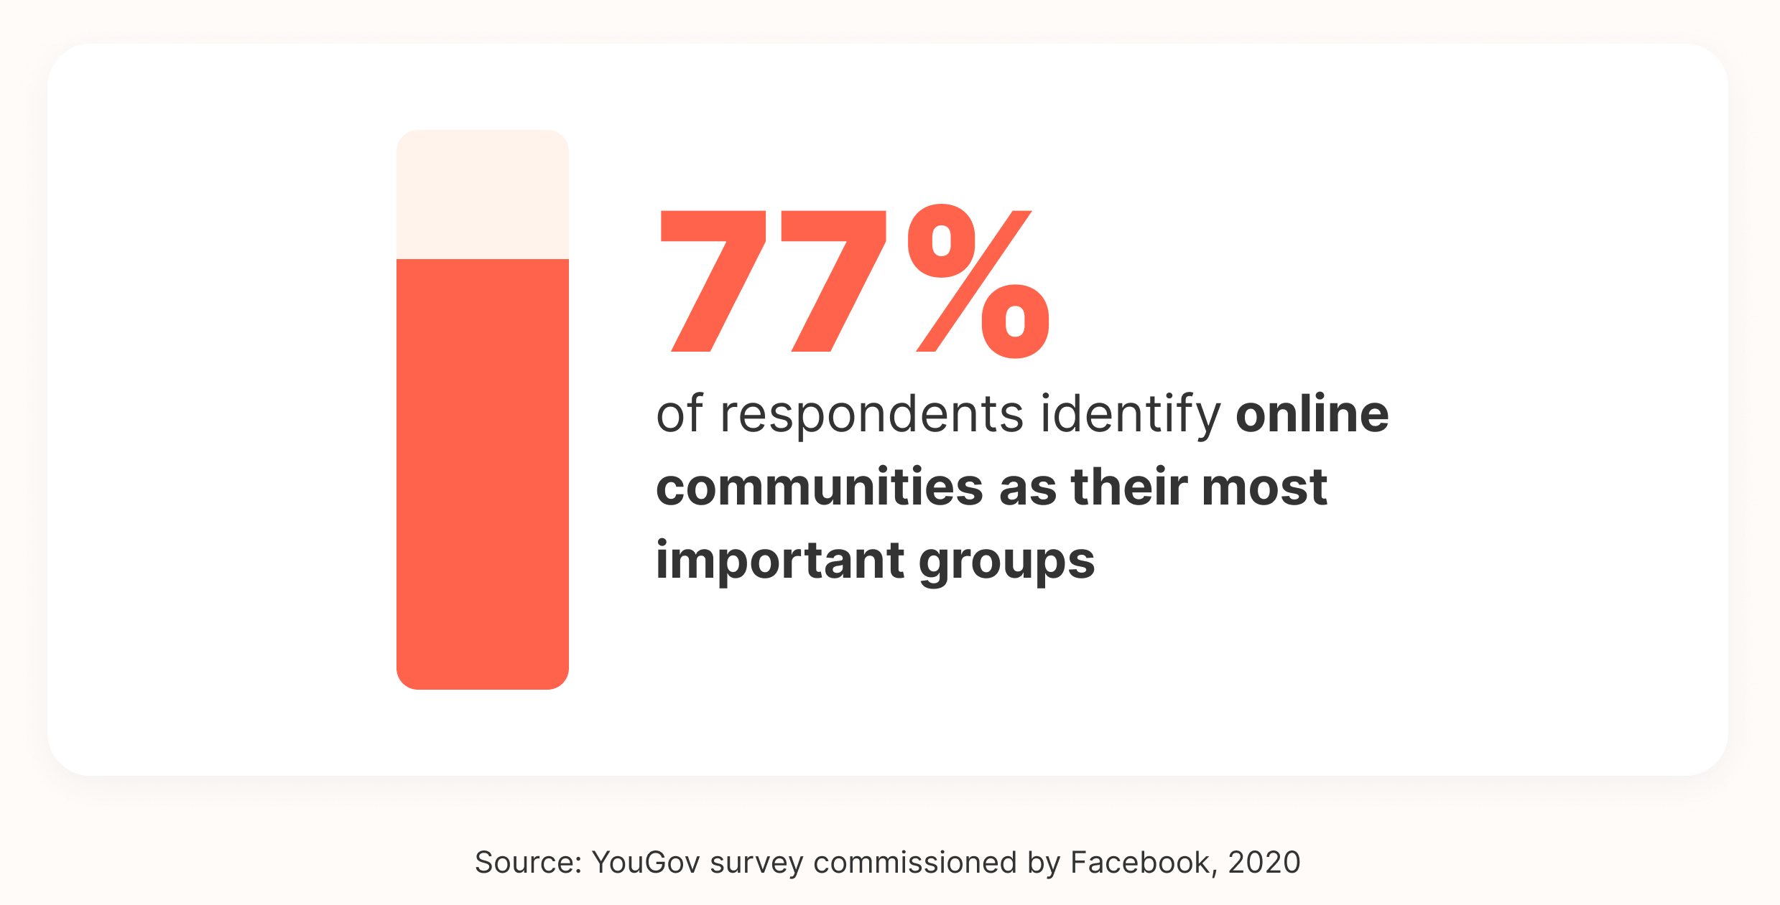
Importance of Community in Higher Education
Here
Students in online courses perform better than traditional courses (Ubell, 2020)
Creates more accessible and inclusive spaces for support (Pelz, 2004)
Venus
Allows for equitable sharing of diverse and inclusive perspectives (Bali, n.d.)
Source: PeerBoard. (2022). Chapter 3: engagement. 105 Online Community Statistics to Know: The Complete List (2022). https://peerboard.com/resources/online-community-statistics#engagement
Mars
Notes:
Online learning is continuing to grow as a platform and with its growth, building community within it is equally important. Ubell notes that research studies have arrived “at essentially the same conclusion: students who take all or part of their classes online perform better than those who take the same course through traditional instruction” (2022, p. 18). With these statistics, it’s important that we continue to build accessible and inclusive communities for these learners. The most important aspect of building community is that it is based in educational theory, particularly in Vygotsky’s social constructivism of learning from peer-to-peer interactions. Learners can build “new or expanded knowledge” when they “engage in common, mutually dependent tasks” or active learning practices (Ubell, p. 27). To build accessible spaces, learners need to feel safe and supported, which is key to the course and community space design. Pelz (2004) notes that students prefer online course interaction because it allows for the anonymity to be open with peers, bond with peers earlier than within a classroom due to online discussion sharing, and the usage of “activities that encourage interaction” (p. 8). Online communities allow for students to share more openly with each other and creates opportunities for interaction that would not be present in a traditional classroom. Finally, online communities create more equitable and inclusive interactions for students. Students online can interact based on their own schedules, which can assist in breaking down barriers to access. It also allows them to engage from a distance, and allows their peers access to perspectives they may not otherwise interact with. It is important for the instructor to engage with these through a lens of cultural humility and social justice, and encourage all learners to share from a place of inclusion (Bali, n.d.).

Slide 10
Accessible Community-Building Tools at EVMS
Pronto
Blackboard
VoiceThread
Collaborate
App for asynchronous and synchronous interactions
Use for discussion board and group interactions
Tool for project and collaborative interactions
Tool for synchronous videoconferencing interactions
Notes:
There are four tools currently at EVMS at that are great for community-building, and all are available within your courses. Our newest tool, Pronto, is an app that integrates within Blackboard, and is available as a mobile and computer app. It creates a space outside of the course for students to interact with each other synchronously and asynchronously to share files, collaborate via text or video, and for the instructor to interact with students. The instructor can also create subgroups within Pronto so students have spaces that may be more specific to their needs for collaboration. The LMS that hosts all of these, Blackboard, is good for traditional-level community-building with discussion boards and grouping. Strategically creating groups in Blackboard, and utilizing group projects/assignments, will promote peer-to-peer interactions within the course. VoiceThread and Collaborate are two more integrated tools within Blackboard. VoiceThread is a great alternative for discussion board posts as it creates audio and video interactions, and promotes collaboration in a more visual format. Collaborate is a video conferencing tool in Blackboard where students can interact with each other, the instructor, and recordings can be saved within Blackboard for later reference. The instructor should use strategic engagement methods with synchronous conferencing when using Collaborate.

Slide 11
Sample- Pronto
Create social communities outside of class
Connect with students in one location
Foster collaboration and interaction
Source: Pronto (2022). BB Intro [Image]. CC by NC.
Notes:
Here you can see Pronto creates a chat and share space for your students. Your students will see all of their spaces in one spot on their app, and you will see yours as the instructor. As the instructor, you can pose questions outside of class to create out of class connections, or create social check-ins with your students. You can also create subgroup spaces for your students to connect with each other without the instructor to discuss coursework, collaborate on projects, and build their own social communities based on their own connections. Pronto creates an inclusive, supportive community for students that is easily accessible to them.

Slide 12
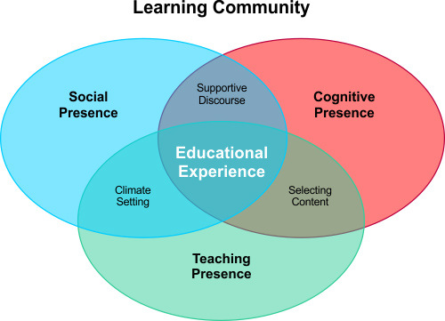
Strategies for Building Communities
In courses, legally defined as the need to afford the “same information, engage in the same interactions,” and provide equitable services to all individuals with equitable ease of use (Burgstahler, 2017)
3 Strategies of Focus:
Utilize Diversity in Ongoing Engagement
Connect Students
Less Lecture, More Discussion
Source: Garrison, et al. 2000. The elements of a learning community [Image]. CC by NC-SA.
Notes:
When considering strategies for building your online communities, be purposeful in your design and consider your goals. Consider what you would like to accomplish in the space, as well as how many spaces you would like to curate, how you will communicate within these spaces, and how you will foster inclusive, accessible interactions with your students. Use your “teaching presence” to fully engage students, and provide interaction opportunities and feedback that “defy the limits of space and time” (Ubell, 2020, p. 28). Also consider you and your students’ social presence you would like to curate, as well as the cognitive presence you are going to foster within the space. While there are multiple strategies for building these communities, we are going to focus on three that are key to creating accessibility and inclusivity in online spaces: utilizing diversity in ongoing engagement, connecting students, and using less lecture and more discussion.

Slide 13
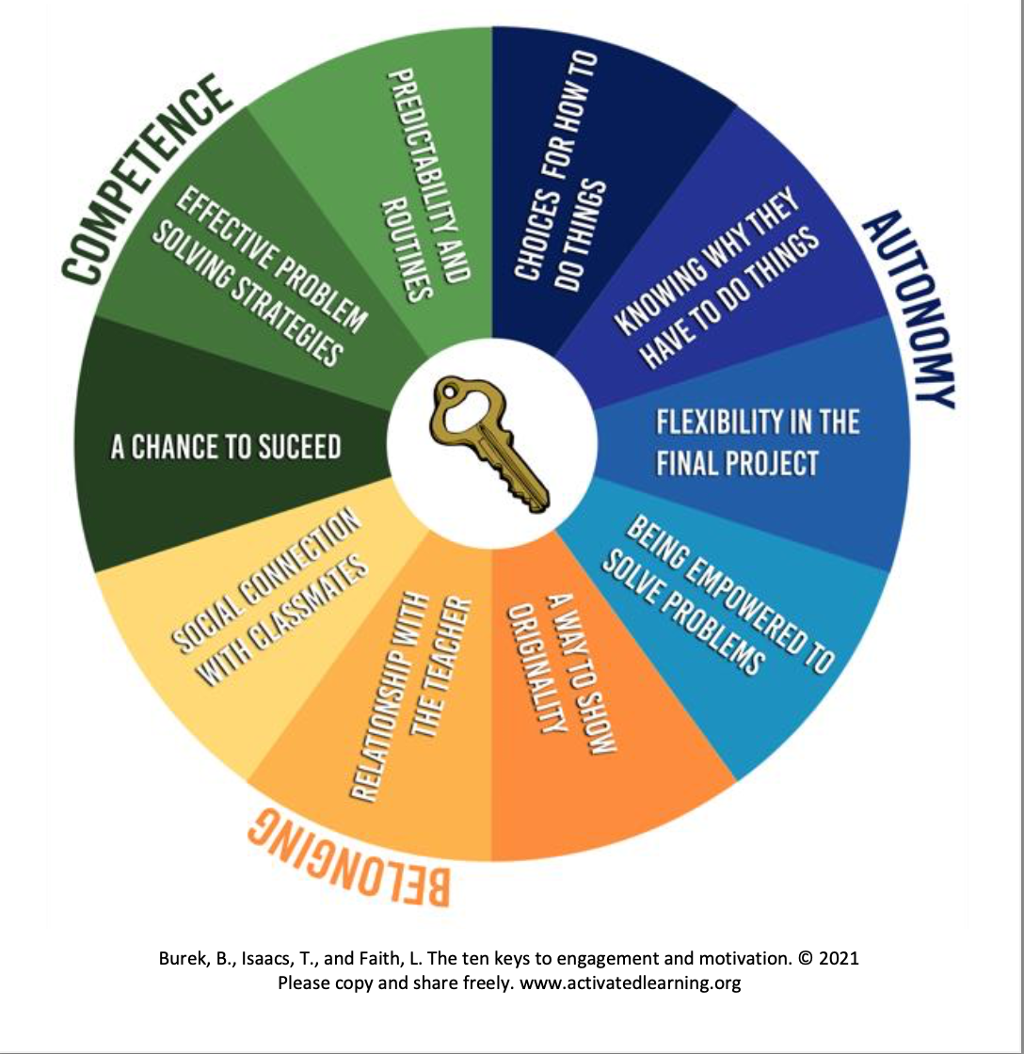
Strategy: Utilize Diversity in Ongoing Engagemment
Ten Keys to Engagement and Motivation (Burek, Isaacs, & Faith, 2020)
Foster diversity, inclusivity, and accessibility
Use a variety of strategies (i.e. Structured Dialogue, Collaborative Lit Review)
Strategy Resources Link
Gather student background to integrate into course design and share with students to create connections (Chawla, 2015)
Create engagement plan and use strategic instructor interaction
Notes:
Create opportunities for ongoing engagement using active learning practices that foster diversity, inclusivity, and accessibility within the course. Within the learning environment, use a variety of strategies, such as a structured dialogue or a collaborative lit review, to engage students with each other and the content of the course (Bali, n.d.). Build rapport with students by getting information about their background during course introductory weeks through conversations and surveys, and integrate student interests and cultural background into the course content. You can also share the results of surveys with students to demonstrate their commonalities, as well as their diversity, with group discussion boards to help students connect with their classmates (Chawla, 2015). As an instructor, this will also help you design your content for the most accessible means possible for your students, and create interactions that include their diverse perspectives and needs. To establish ongoing engagement, create a plan for how you would like this engagement to look. Consider when you would like students to interact, how you would like them to interact, and in what format. Provide these parameters to students, and establish guidelines for their communication. Encourage diverse perspectives to be shared within the space, and interject with your own perspectives to interact with the student discourse. Within this environment, as an instructor, build relationships with students through meaningful feedback and conversations (Beauchamp, et. al, 2020).

Slide 14
Strategy: Connect Students
Connect students to each other, the instructor, and the course content
Create channels of effective, accessible, and inclusive two-way communication
Encourage collaboration between students inside and outside the learning environment
Encourage shared discourse amongst students in shared spaces
Create a sense of belonging rooted in compassion and empathy
Notes:
Connecting students to each other, the instructor, and the content is important in creating an inclusive, accessible learning community. The first step to connecting students is to have effective channels of two-way communication. As a part of your engagement plan, knowing what ways you are communicating which types of information is important to connecting the students to that information, and ensuring students are actually receiving that information. The next step is strategically connecting students with other students in the course, and connecting students with you the instructor. As the instructor, encourage collaboration between students in the learning environment using active learning strategies to build on their prior learning experiences through the knowledge of others, provide opportunity for critical thinking and reflection, and implement meaningful questions within discussion boards (Ubell, 2020, p. 26). Also encourage students to work together outside of the course through technologies like Pronto and Collaborate, where they can share discourse synchronously and asynchronously on coursework, build their own social community, or ask questions that require instructor interaction. Finally, connect yourself to students through compassion and empathy. Both aforementioned emotions are essential to creating a sense of belonging for students, and contribute to the positive “health and well-being of all students.” Root yourself in a lens of empathy and compassion when interacting with students for the most inclusive, equitable environment and help your students feel they belong in your learning community (Beauchamp, et. al., 2020).

Slide 15
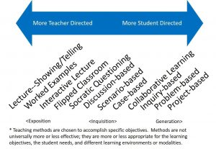
Strategy: Less Lecture, More Discussion
Promote more interactions between students and less lecture time
Promote critical thinking, reflection, and active-learning practices within the course
Use a flipped classroom model
Resource link here
Encourage student-led discussion, including in asynchronous posts
Resource link here
Source: UCF. (n.d.) Teaching methods overview [Image]. CC by NC.
Notes:
Elvis may have said “A little less conversation, a little more action,” but we want to have more conversation outside of the lecture. Within your course, focus less on the lecture and more on the discussion and interactions between students. Use active learning strategies to engage students in your content, and promote peer-to-peer interaction frequently throughout your course. Limit lecture time and increase time for student discussion, such for critical thinking, reflection, and Socratic Seminar within the course. You can also use the flipped classroom model, where students review course content on their own time and apply the knowledge from this content during class time using small group activities. This allows the instructor to act as a facilitator and promotes student-led discussion (Berry, 2019). The instructor should also include student-led discussions during course-time, including student created asynchronous discussion board posts and curated resources for critical reflection. These can open the floor for diverse perspectives and create an inclusive atmosphere, where all students feel represented within the class space.

Slide 16
Invitiation to Share
What strategies or tools from this presentation are you interested in using?
What questions do you have?

Slide 17
Thank you!
Questions or want support in implementing these into your work? Contact us!
EVMSOnline@evms.edu
https://www.evms.edu/education/online/

Slide 18
References
Ahlquist, J. (2020). Building online community for college students [Webinar]. Accessed 31 Oct. 2022. https://www.josieahlquist.com/building-online-community-for-college-students/
Bali, M. (n.d.). Intentionally equitable hospitality [video]. Learning Path: Community Building. https://onehe.org/resources/community-building-online/
Barry, S. (2019). Teaching to connect: community-building strategies for the virtual classroom. Online Learning, 23(1), 164- 183. https://doi.org/10.24059/olj.v23i1.1425
Beauchamp, J., Schwartz, E., & Davidson Pisacreta, E. (2020). Seven practices for building community and student belonging virtually. ITHAKA S+R. https://doi.org/10.18665/sr.313740
Burgstahler, S. (2017). ADA compliance for online course design. Why IT Matters to Higher Education: EDUCAUSE Review. Accessed on 28 Oct. 2022. https://er.educause.edu/articles/2017/1/ada-compliance-for-online-course-design
Chawla, K. (2015). 5 essential steps to building community for your online course. EdSurge. https://www.edsurge.com/news/2015-06-24-5-essential-steps-to-building-community-for-your-online-course
Holistic. (2021). Inclusive language toolkit. Author.
LNESC. (2022). Non-traditional students. LULAC National Educational Services Centers. Accessed on 28 Oct. 2022. https://www.lnesc.org/resources/nontraditional_students/
Pelz, B. (2004). (My) three principles of effective online pedagogy. In Pilcher, A. (2016). Establishing community in online courses: A literature review. College Student Affairs Leadership, 3(1). http://scholarworks.gvsu.edu/csal/vol3/iss1/6
Pilcher, A. (2016). Establishing community in online courses: A literature review. College Student Affairs Leadership, 3(1). http://scholarworks.gvsu.edu/csal/vol3/iss1/6
Virginia Department of Education. (2020). Navigating edequity. Author.

