Slide 1
Facilitating Online Discussions
Instructional Design and Technologies

Slide 2
Learning Objectives
Explain the importance of effective online discussion facilitation
Describe different tools for facilitation online discussions
Analyze different strategies for facilitating effective online discussions

Slide 3
Join us on Padlet for our first interaction where you will answer QUESTION 1 ONLY. Please use the QR code OR the link below: https://padlet.com/IDTevms/NDLW22discuss
Padlet Interaction 1

Slide 4
Importance of Effective Online Discussion
Creates meaningful peer-to-peer and learner-to-content interactions
Builds critical thinking and reflection skills
Connects learners across space and time
Notes:
Engaging in peer-to-peer interactions and interacting with content is important in active learning processes, and key to students’ attainment of content. These interactions need to be meaningful and sustained in order for students to get the most out of their learning experiences. It is even more crucial for students in the online environment to interact with each other through a variety of discussion methods in order to create relationships with the content, reflect internally, and critically think with each other. Per Grandzol & Grandzol (2010): “requiring student interaction just for the sake of interaction may lead to diminished completion rates… standards for online teaching should not contain arbitrary thresholds for required interaction.” (p. 9). While requirements are important to substantiating online discussions, making them meaningful, connecting them to real-world experiences, and placing requirements that are reflective of student experiences will help students to connect to the content.

Slide 5
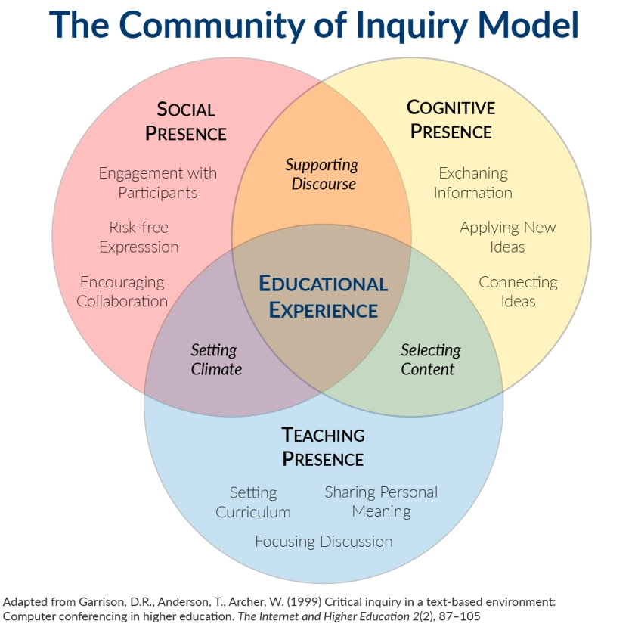
Discussion and COI
Effective teaching uses the Community of Inquiry Model (COI) which becomes important to consider when facilitating discussions.
Notes:
Effective teaching follows the community of inquiry, which becomes even more important to consider in facilitating online discussion. Establishing a teaching presence will help foster students’ social and cognitive presence, and engage them in higher order thinking skills. It will also help students to explore new ideas through probing questions, create a safe space for inclusive sharing, and create a space for academic discourse.

Slide 6
Types of Online Discussions
Asynchronous
Synchronous
Delayed response time, but allows for cognitive processing
Students have increased reflection time and is accessible for those on different schedules
Best for complex issues
In real-time and supports active participation
Students have increased commitment and participation because of time expectations
Best for brainstorming, task-planning, and lower-complex issues
Notes:
There are two types of online discussion: asynchronous and synchronous. Asynchronous is mostly accomplished through discussion tools (i.e. Blackboard discussion board, VoiceThread), emails, and chat apps (i.e. Pronto, WhatsApp). The individual answers at their own pace and time, based around the requirements of the assignment or specific deadlines. Students have more accessibility in response time, as well as an increase in time for reflection and composition of responses. This leaves asynchronous discussion best for complex issues, as students have the time and resources to delve into the content.
Synchronous discussions occur in real-time and support active participation strategies. This type of discussion is show to have increased student commitment and active participation due to the time expectations for students. The individual has set time parameters for responses based on the meeting time. These discussions are best for brainstorming as a group, task-planning for large projects, and lower-complex issues in content matter (Ragupathi, 2018, p. 2).

Slide 7
Purposeful Discussion
No matter the mode of discussion, there are four categories to how students use discussion to obtain information and interact with others (Ragaputhi, 2018).
Notes:
All modes of discussion can traditionally be classified into four categories: to check ideas, acquire new ideas, develop ideas, and challenge ideas and beliefs. To delve deeper into content and information, discussions should focus on developing and challenging student ideas. Effective discussions can do so by building upon prior knowledge that is shared with peer-to-peer interaction. These interactions can also transform ideas into a different category: arriving at a “shared understanding” (Ragaputhi, 2018). Sometimes students will need scaffolding in order to effectively share and collaborate effectively with their peers, so tools and strategies should be put into place in order to meet students where they are at in order to bring them to where they need to be. For example, encourage students to analyze their own experiences before analyzing another’s, and if needed, provide model sentence question structures for this analysis.

Slide 8
Join us on Padlet for our first interaction where you will answer QUESTION 2 ONLY. Please use the QR code OR the link below: https://padlet.com/IDTevms/NDLW22discuss
Padlet Interaction 2

Slide 9
Discussion Tools
Classroom Forums
Videoconferencing
Docs & Presentations
Includes Blackboard discussion boards, email, and Blackboard groups
Provides media & collaboration-rich synchronous opportunities
Includes cloud docs, media presentations, journals, and ebooks
Voice Boards
Videos & Podcasts
Wikis & Blogs
VoiceThread and Pronto
Media and collaboration rich
Provides media and collaboration-rich opportunities sync and async
Collaboration and media rich in async format
Notes:
There are a variety of discussion tools to accomplish both asynchronous and synchronous tasks, and engage your students. It is important to determine what you would like your students to engage in, and how you would like them to engage, before choosing the tool you would like them to engage through. It is also important to set up parameters and requirements within the tool to successfully facilitate effective engagement amongst learners within the tool itself. For example, if you are looking for students to have rich collaborative sessions in a synchronous format, then a videoconferencing tool may be a better option. However, if you are looking for students to have rich media-sharing experiences with their collaboration, and have the flexibility of asynchronous collaboration, then using wikis may be a better fit for that objective.

Slide 10
Strategies for Online Discussion Through COI
Social
Cognitive
Teaching
Purposeful communication in an inclusive environment
Facilitate construction of meaning
Focus on facilitating discussion, designing interactions, and direction
Notes:
The instructor becomes the facilitator within the active learning classroom. In effective online discussion facilitation, the three domains of the community of inquiry can be focused upon when applying strategies to ensure discussion is effective, accessible, and inclusive for all students (Baker, 2015).

Slide 11
Basic Discussion Management
Set clear and explicit expectations
Identify clear participation goals for students (in-class and extension)
Clearly communicate goals and prompts
Provide a schedule dileneating asynchronous and synchronous
Induct students into discussion tools and expectations within first week of course
Participate and be visible in discussions
Make regular announcements to pre-empt discussions with relevant content
Reserve specific time to monitor/respond to discussions
Develop a FAQ section for module(s) based on student questions
(Ragaputhi, 2018)

Slide 12
Social Presence Strategies
Create a safe space
Relationship-building
Social spaces
Create forums/spaces for specific topics
Create strategic opportunities for student interactions
Be visible and present in discussion forums
Notes:
Create a safe space for students by first opening the door for relationship-building through introductions and getting to know students on a personal level. Build space for inclusivity and accessibility in discussion forums as you get to know your students’ needs, interest, and cultural backgrounds. Additionally, create social spaces for them through learning tools like Pronto.
Create forums for specific topics to help focus conversation or promote dialogue on a specific topic. This may also help create strategic opportunities for students to engage with one another, but this can also be accomplished through grouping, discussion requirements, and collaboration expectations in synchronous settings. Finally, as the instructor, be visible and present in the discussion forums. Model expectations for students, but also allow them to see a bit of your personal side so they can connect with you (Baker, 2015).

Slide 13
Cognitive Presence Strategies
Provide explicit and timely feedback
Create discussion summaries
Don’t remove past discussion opportunities within the course
Allow for offline viewing
Frame questions through critical lens
Use Blooms to scaffold up or down
Provide models and references
Create space for content-specific questions
Use a variety of discussion methods and tools
e.g. repository creation, collaborative writing, student-created questions
Notes:
To provide effective cognitive presence, focus on providing students effective and timely feedback on their work in both asynchronous and asynchronous settings. Students want to know how they’re doing and want to hear from you in a timely manner. You word is meaningful to them, so share it with them in a constructive manner. To assist in knowledge construction, create discussion summaries in postings, as well as ensure the discussion work stays posted and is available for offline viewing. This should include audio, video, and multimedia collaboration. When creating discussion, create questions through a critical and reflective lens that align to Blooms taxonomy. If needed, scale down in the verbs before rising back up to meet students where they need to be to create an inclusive learning environment. Also, create a space for content-specific questions that students can ask asynchronously within the course.
Finally, and most importantly- switch it up! Use a variety of discussion methods and tools for students. Engage them with different strategies, like Socratic Seminar, a repository creation, have them write their own questions, or collaborate in writing together. Act as a facilitator to engage them in critical thinking processes and build self-regulatory skills to activate cognitive growth.

Slide 14
Teaching Presence Strategies
Applies to all areas of the online classroom
Explain the discussion and relevant course design to students
Set and reinforce expectations for students (purpose, requirements, roles)
Engagement plan
Tools, groups, discussions and assignments, procedural question spaces
Provide opportunities for extended discussion and real-world connections
Notes:
Finally, entwine your teaching presence into the social an cognitive presence of the discussion area, but also in all areas of your online classroom. Your teaching presence is vital in every area of the online classroom, as even though students can’t “see” you in person, they can still “see” you online through your virtual presence. Through induction, explain the discussion and relevant course design to students so they have a grasp on what is expected of them, as well as the relations between components of the course. This will help in setting and reinforcing the purpose, requirements, and roles for students during the course, as they will understand why they are required to do specific tasks. As an instructor, this should be a part of your engagement plan that is created before the course and modified throughout the course as needed. Choose the tools for discussion and engagement, plan groups for collaboration, create the discussion questions and assignments, and create procedural question spaces for students. Finally, create opportunities for dialogue to extend beyond the classroom and for students to make connections to themselves and the world around them.

Slide 15
Notes of Caution
Assess student progress via discussion
Monitor group dynamics
Consider individual vs. group communication
Have a plan for continuous engagement
Notes:
With all aspects of pedagogy, there are always notes of caution. Remember to continuously assess students’ understanding through discussion, as it will make the task meaningful to them for completion and you to have a grasp on students you cannot see. When creating groups, check in on them and monitor their dynamics to ensure unity. Build in self-regulation of teamwork into their assignments so they can self-report, or self-check in, based on their collaboration status. When communicating with students, consider your methods of group versus individual communication, and how this may also impact your discussion forums as well. Finally, as previously stated: always plan. Have an engagement plan and modify as needed based on the needs of the learners in your classroom.

Slide 16
Join us on Padlet for our first interaction where you will answer QUESTION 3 ONLY. Please use the QR code OR the link below: https://padlet.com/IDTevms/NDLW22discuss
Padlet Interaction 3

Slide 17
Thank you!
Questions? Strategies or tools you would like to implement?
Contact IDT!
EVMSOnline@evms.edu

Slide 18
References
Baker, J. D. (2015). Facilitating online discussions [presentation]. Regent University.
Grandzol, C. J. & Grandzol, J. r. (2010). Interaction in online courses: More is not always better. Online Journal
of Distance Learning Administration, 9(2). https://ojdla.com/archive/summer132/
Grandzol_Grandzol132.pdf
Ragupathi, K. (2018). Facilitating effective online discussions resource guide. Centre for Development of
Teaching and Learning (CDTL).

