Slide 1
Specifications Grading
“My professor failed me with a B!”

Slide 2
Specifications Grading: Restoring Rigor, Motivating Students, and Saving Faculty Time
Linda B. Nilson
Notes:
2014

Slide 3
15 Criteria for Grading Systems
Uphold high academic standards
Grades reflect student learning outcomes
Grades motivate students to learn
Motivation should have students trying to excel
Grading discourages heating
The system should reduce student stress
Students should feel responsible for their own grades
Minimizes conflict between faculty and students
Should save faculty time
Give students feedback that they will use to improve their work
Make performance expectations clear
Fosters a higher level of cognitive development
Should assess authentically
Likely to have a high rate of interrater reliability
Simple and therefore understandable

Slide 4
Unique Aspects of Specifications Grading
Instructor identifies competency tasks
Clear, concise, specific, objective ‘hurdles’
Grade relates to number or difficulty of tasks
Each task is pass or fail, tokens for redemption
Tasks translated to bundles for course grade
Notes:
High jump & hurdle

Slide 5
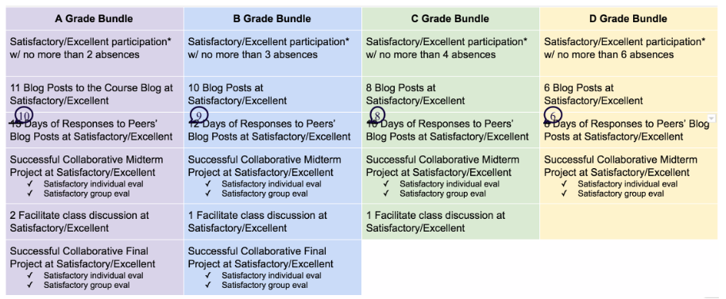

Slide 7
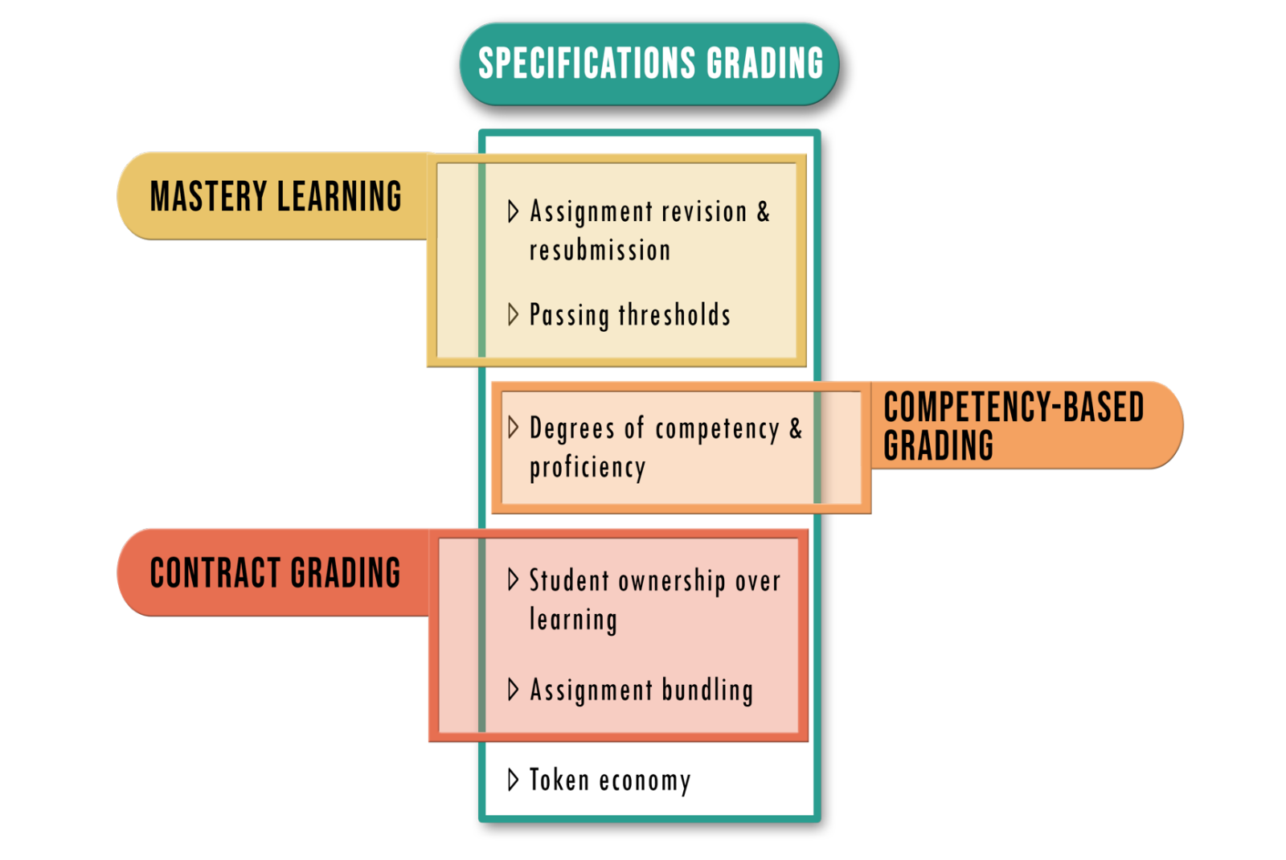
STUDENT MENTAL HEALTH
Notes:
Bonner, M. W. (2016). Grading Rigor in Counselor Education: A Specifications Grading Framework. Educational Research Quarterly, 39(4), 21-42.
Katzman, S. D., Hurst-Kennedy, J., Barrera, A., Talley, J., Javazon, E., Diaz, M., & Anzovino, M. E. (2021). The effect of specifications grading on students’ learning and attitudes in an undergraduate-level cell biology course. Journal of Microbiology & Biology Education, 22(3), e00200-21.
Vitale, S. E., & Concepción, D. W. (2021). Improving Student Learning with Aspects of Specifications Grading. Teaching Philosophy, 44(1), 29-57.

Slide 8
Tokens
A form of currency which shift power from faculty to students and can be spent during a course to buy exceptions to the rules.
Given v Earned
Unlimited v Limited
Full Revision v Partial Revision
Notes:
Mini-economy

Slide 9
Impact of Second Chances
Higher grade distribution^{1,4,6}
Higher content knowledge^{1,4}
Increased enthusiasm/motivation^{1,2,3,5}
Increased sense of support^{2,5}
Reduced pressure^{2,3,6}
Notes:
Katzman, S. D., Hurst-Kennedy, J., Barrera, A., Talley, J., Javazon, E., Diaz, M., & Anzovino, M. E. (2021). The effect of specifications grading on students’ learning and attitudes in an undergraduate-level cell biology course. Journal of Microbiology & Biology Education, 22(3), e00200-21.
Elkins, D. M. (2016). Grading to learn: An analysis of the importance and application of specifications grading in a communication course. Kentucky Journal of Communication, 35(2).
Pope, L., Parker, H. B., & Ultsch, S. (2020). Assessment of specifications grading in an undergraduate dietetics course. Journal of Nutrition Education and Behavior, 52(4), 439-446.
Mendez, J. (2018). Standards-based specifications grading in thermodynamics. ASEE
Gargac, J. Incorporating Industry-based Metrics into a Specifications Grading System for Capstone Assessment.
Evensen, H. (2022, August). Specifications Grading in General Physics and Engineering Physics Courses. In 2022 ASEE Annual Conference & Exposition.

Slide 10
Specifications Grading & Token Systems
Benefits
Challenges
Questions

Slide 11
Specifications Grading
“My professor failed me with a B!”

