Slide 1
Accessibility at EVMS: Creating content for everyone
National Distance Learning Week
Kevin Green, Digital Accessibility Specialist
Notes:
Who am I? Digital Accessibility Specialist position overview
Goals for the presentation
Provide an overview of accessibility (the laws, guidelines, etc.)
Show what resources are available at EVMS and beyond
This is a huge topic to cover. Remember - any progress is good progress!

Slide 2
What is accessibility?
Definition: A website or web application’s content and features can be understood and used by anyone, regardless of technology or ability.
Examples
Websites: evms.edu, myportal.evms.edu, sentaraevms.com
Web applications: Outlook, Adobe Acrobat, Twitter, Facebook
Content: Words on a webpage, documents (PDF, Word, PowerPoint), media (images, video [linked or embedded from platforms like YouTube])
Features: Play/pause button, navigation menu, search bar
Notes:
Differences between website and web application
Website: Informational content (text, images, videos, etc.)
Web application: More interactive, allowing users to populate content
Everything must be accessible – shown through examples later on

Slide 3
Benefits of accessibility
Closed captioning: Can help someone trying to watch a lecture in a quiet library
Descriptive alternative text (alt text): Replacing a large image can help students with slow internet connections
Fillable online forms: Can be a good substitute for PDF forms
Alt text: Dog wearing glasses working at laptop
Notes:
Accessibility does not solely benefit those with disabilities
PDF’s can be extremely difficult to make accessible

Slide 4
More benefits of accessibility
Reach a wider audience
Google rates your website based on its accessibility
1 in 4 adults (61 million) have reported living with a disability (according to CDC study)
Protect your organization
Website accessibility lawsuits have risen by more than 200% since 2017
Non-compliance penalties can range from $55,000 to $150,000
Notes:
Strong SEO: Google is the biggest screen reader in the world - Keith Bundy
Takeaway: The impact is real, and often involves money
Non-compliance penalties with the ADA can range from $55,000 to $150,000
MIT settled for $1M plus attorney fees

Slide 5
Accessibility: An obligation, not an accommodation
Section 508 of the Rehabilitation Act of 1973
Requires institutions like EVMS to develop, procure, maintain or use accessible websites and web applications.
Users do not have to request websites or web applications be made accessible.
Americans with Disabilities Act (ADA)
Frequently cited in lawsuits concerning accessibility of websites.
Department of Justice guidance: ADA requirements can apply to websites for public businesses as well as state and local governments.
Notes:
What is the law?
Section 508 differs from Section 504, which largely deals with public spaces
ADA is frequently cited in lawsuits
DOJ released guidance in March
Basically: ADA requirements can be applied to websites

Slide 6
The EVMS Standard
All web content must meet (or exceed) Levels A and AA Success Criteria in Web Content Accessibility Guidelines (WCAG) 2.0.
These guidelines apply to:
Websites, web applications
Social media posts
Learning Management Systems (e.g. Blackboard)
Digital Documents (e.g. Microsoft Word, PDF)
Notes:
Both Section 508 and ADA reference the Web Content Accessibility Guidelines
About WCAG
Developed by the World Wide Web Consortium (W3C)
Can be applied to examine/enhance the accessibility of websites, social media, learning management, digital documents

Slide 7
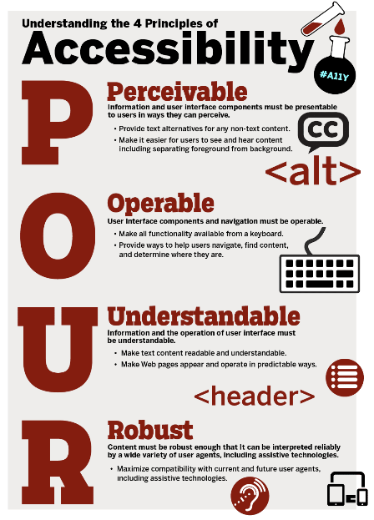
Understanding WCAG
Organized into 4 Principles covering 13 Guidelines and 38 Success Criteria for EVMS Standard.
The four principles (POUR)
Perceivable
Operable
Understandable
Robust
The principles as broken down by The A11y Project
Notes:
The A11Y Project is an open-source website that promotes accessible and inclusive digital experiences.
The Web Content Accessibility Guidelines (both 2.0 and 2.1) are organized into 4 Principles covering 13 Guidelines and 61 total Success Criteria between three levels (A, AA, AAA). Section 508 requires entities that receive federal funds to meet or exceed Level AA. This means there are 38 Success Criteria that need to be met in order to ensure compliance. Some criteria will directly apply to moderators and others are more for developers. Around half apply to content moderators.
The Principles
Perceivable: "Information and user interface components must be presentable to users in ways they can perceive."
Operable: "Make all functionality available from a keyboard."
Understandable: "Make text content readable and understandable."
Robust: "Maximize compatibility with current and future user agents, including assistive technologies."
The Guidelines
Guideline 1.1 – Text Alternatives: "Provide text alternatives for any non-text content so that it can be changed into other forms people need, such as large print, braille, speech, symbols or simpler language."
Guideline 1.2 – Time-based Media: Provide alternatives for time-based media.
Guideline 1.3 – Adaptable: Create content that can be presented in different ways (for example simpler layout) without losing information or structure.
Guideline 1.4 – Distinguishable: Make it easier for users to see and hear content including separating foreground from background.
Guideline 2.1 – Keyboard Accessible: Make all functionality available from a keyboard.
Guideline 2.2 – Enough Time: Provide users enough time to read and use content.
Guideline 2.3 – Seizures and Physical Reactions: Do not design content in a way that is known to cause seizures or physical reactions.
Guideline 2.4 – Navigable: Provide ways to help users navigate, find content, and determine where they are.
Guideline 2.5 – Input Modalities: Make it easier for users to operate functionality through various inputs beyond keyboard.
Guideline 3.1 – Readable: Make text content readable and understandable.
Guideline 3.2 – Predictable: Make Web pages appear and operate in predictable ways.
Guideline 3.3 – Input Assistance: Help users avoid and correct mistakes.
Guideline 4.1 – Compatible: Maximize compatibility with current and future user agents, including assistive technologies.

Slide 8
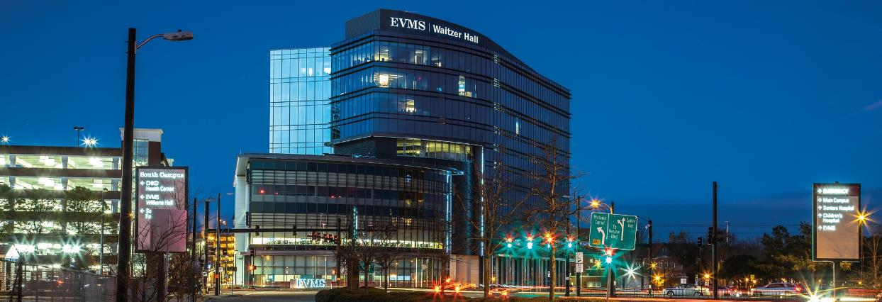
Who is responsible?
Short Answer: Every department at EVMS

Slide 9
OK…but who is responsible?
Long Answer: Anyone preparing content for any EVMS online entity, including websites, web applications and social media channels, must take responsibility for ensuring it meets accessibility standards.

Slide 10
Is your content accessible?
Audit by AAAtraq with Gallagher and Wilson Elser: 96% of 2,000 higher education website homepages “failed to be inclusive”
Plantiff lawyers often focus on three vulnerabilities
Alt text
Link text
Form labels
Notes:
How does one go about making content accessible?
Looking at a few examples based on these three areas

Slide 11
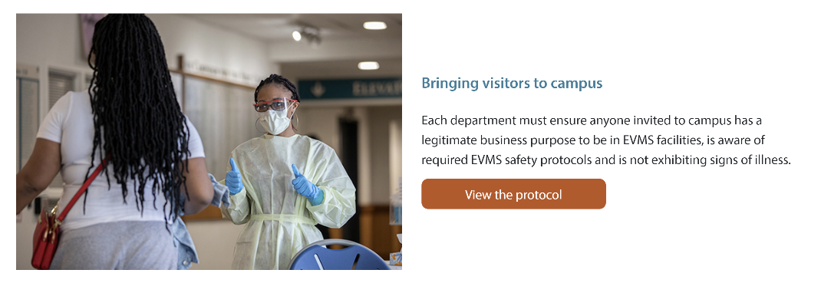
Alt text: Context is everything
Convey the meaning of the image within the context of the webpage, LMS section, document, etc.
Alt text: Screener wearing a mask and scrubs speaks to a person at an entrance
Notes:
Alternative text is meant to be a short line of text that describes the image to someone
What is the meaning or purpose of this image?
Example from the COVID-19 website

Slide 12
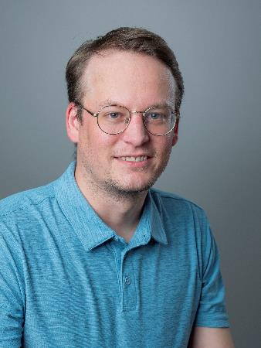
Alt text: Profile images and logos
Alt text: Kevin Green
Alt text: National Distance Learning Week 2022 logo
Notes:
A profile image or headshot is a nice visual to show what a person looks like
Answer is mostly going to be simple: their name

Slide 13
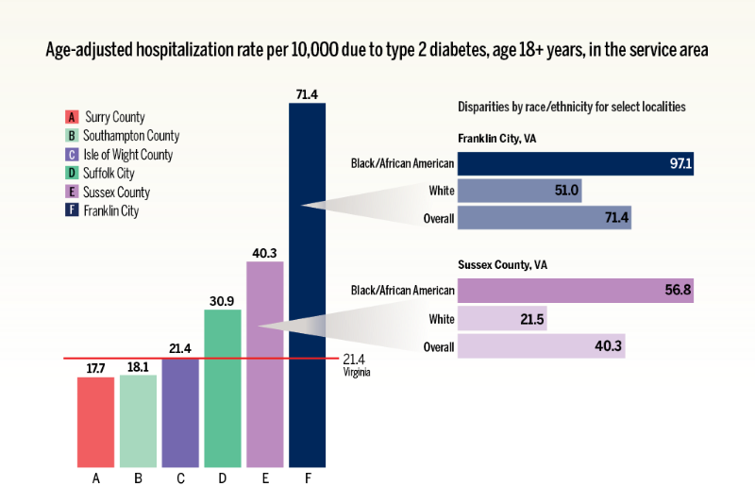
Alt text: Complex images are difficult (not impossible)
Avoid images of text (e.g. flyers); consider a webpage
Supplement complex images (e.g. bar charts, graphs) with long descriptions to capture the full meaning
Notes:
Example image is a bar chart from a story published in the EVMS Pulse

Slide 14
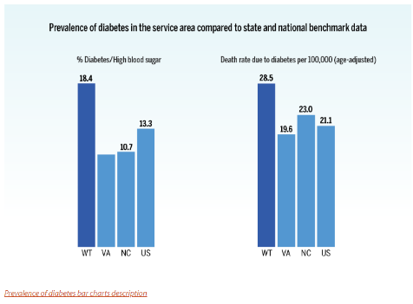
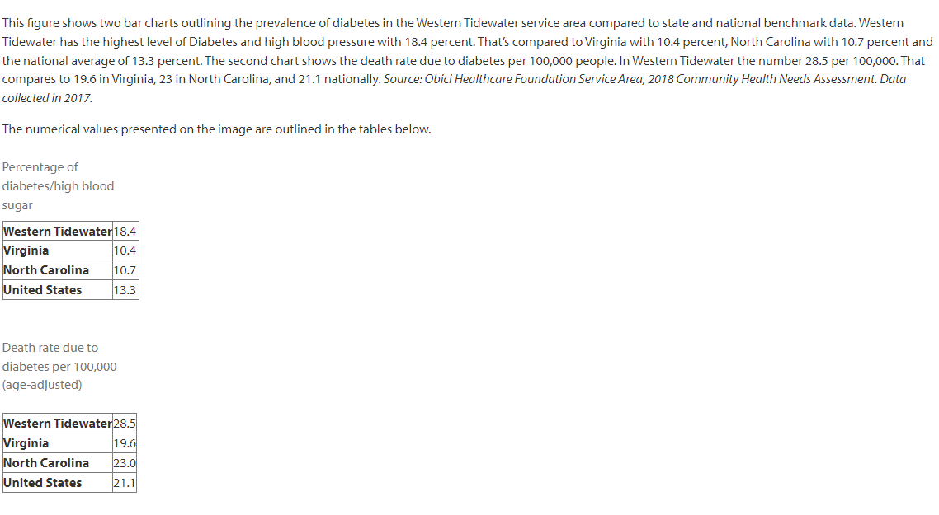
Alt text: Long description solution
EVMS Pulse story – “EVMS project targets diabetes in Western Tidewater”
Alt text: Bar graph showing high prevalence of diabetes in Western Tidewater. Full description in the link below.
Notes:
EVMS Pulse example
Magazine story from November 2021
“EVMS project targets diabetes in Western Tidewater”
Featured three complicated images
Solution: Separate page where we linked to the longer description

Slide 15
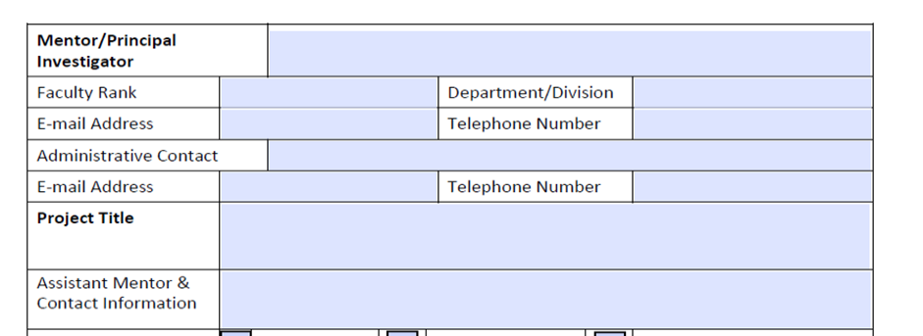
Online form example: PDF
Summer Scholars mentor application
Notes:
This is an example of a PDF application for Summer Scholars
I helped work on the accessibility of this PD

Slide 16
Online form example: The challenge of PDFs
The Nielsen Norman Group has researched PDF usability extensively
They have found that PDFs:
Create a disorienting user experience
Users strongly dislike PDFs
Notes:
PDFs are ubiquitous and difficult
According to the Nielsen Norman Group PDFs:
Are “often optimized for a printed sheet of paper” and not a browser window
Can be slow to load on desktop and mobile
When opened in a new tab, can disorient users because PDFs lack standard navigation
Can make it difficult for users to find information if they have to scan a table

Slide 17
Online form example: PDF remediation
The fixes might be tedious and difficult
Notes:
Big challenges with this form
Each form field has to be manually labeled to convey to a screen reader the information needed for the field
A form like this can often be tagged as a table – which is its own brand of crazy in PDFs

Slide 18
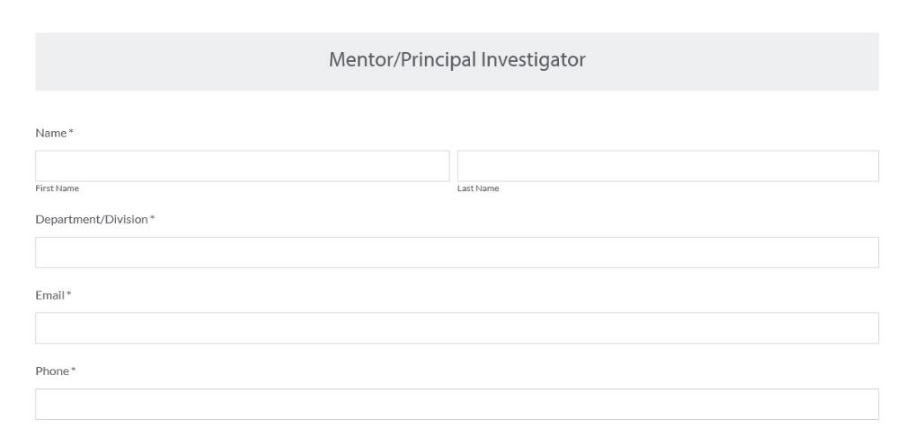
Online form example: Accessible alternative
Embeddable form built through Formstack
Notes:
An application such as Formstack
Does a lot of the work
Works a lot better on mobile
Reach out to Web Technologies (webmaster@evms.edu) to learn more.

Slide 19
Links: Be descriptive
Avoid “click here” or “read more”
Provide context that describes the purpose of the link
Links can be buttons or part of a sentence
Avoid linking headers (not enough context)
Notes:
Two way to link: a CTA button or meaningful text within a graph or paragraph
Linking headers can be confusing since headers are generally more broad and are meant to label chunks of information
In the example here
The Continuity of Operations Task Force is linked and goes to a page with more information about the task force
“Read the message” is designed as a call-to-action to compliment the text to the left

Slide 20
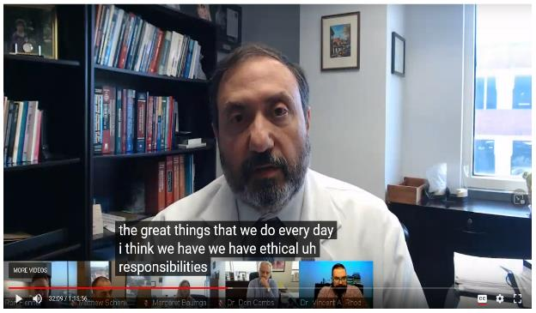
Videos and text alternatives
In general: Close captions and transcripts over open captions and subtitles
For live events: Live captioning helps in the moment
Recorded videos
Develop a script with captions ahead of time
Auto-captions and edit later
Third party (and pay)
Notes:
Multimedia (videos, podcasts, etc.) require some kind of text alternative
Close captions and transcripts preferred over open captions and subtitles
3Play Media Study (w/ Oregon State) from 2016
Looked at how and why students use captioning
Over 2,000 students from 15 institutions responded
Note: Many of these institutions were only thinking about CC as it related to accommodation -- so some only sent out surveys to students registered
13% registered with an office of disability services; 10.7% identified as having other disabilities
99.7% had courses that included videos
Takeaways: "Students who do not require closed captioning or transcripts for accommodation are using these tools in a range of ways to access videos and support their learning“
Live captioning is important for events (like Commencement or this one!)
Three ways to work with live or recorded videos:
Develop a script (and stick to it); this can help with editing
Auto-captions and edit later (easy route)
Pay a third party. This can get costly

Slide 21
Resources for captioning
Panopto and Blackboard Collaborate
Live captions and auto captions
Ability to edit captions
Email evmsonline@evms.edu for assistance
EVMS YouTube channel
Can be embedded on evms.edu
Email news@evms.edu to get started with uploading videos
Third-party services
Rev and 3Play Media
Caption videos at varying costs

Slide 22
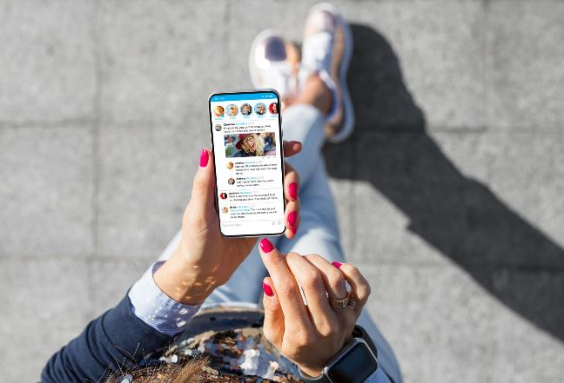
Social media and accessibility
Hashtags: Capitalize first letter of each word in multi-word hashtags. Examples: #WhiteCoatCeremony, #ClassOf2023
Images: Add alt text in advance settings (separate from image caption)
Visit evms.edu/socialmedia to learn more about applying for an approved account.

Slide 23
Now what?

Slide 24
Things to keep in mind
Know the rules
Make a plan and get started
Don’t try and solve it all at once (chip away at the iceberg)
You are not alone

Slide 25
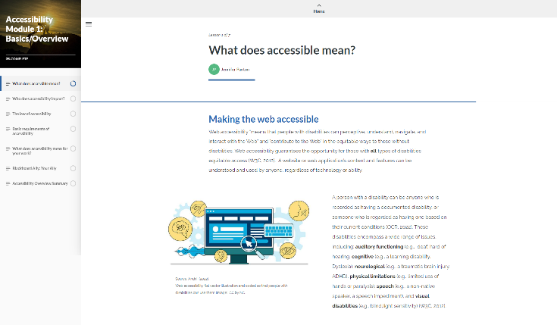
Available training at EVMS
Rise Modules: Accessibility Basics (available now)
More modules to come: Documents, PDFs, Multimedia
Continuing Education credit
EVMS Accessibility Website
Creating Accessible Webpages
Creating Accessibile PDFs

Slide 26
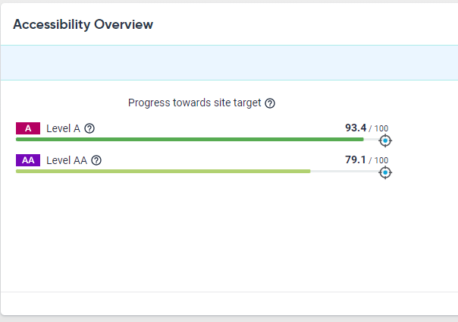
Using Siteimprove
How it works
Scans your evms.edu webpages for accessibility, broken links and more
Monthly reports sent to departments
User access available to trained T4 moderators
SiteImprove Academy: Courses for Siteimprove Users and non-users
Visit evms.edu/siteimprove to learn more about reports and access

Slide 27
Blackboard is your Ally
Ally: Integrated into Blackboard to assist instructors in making more accessible digital course content.
What Ally provides
Essential checks on instructor-added documents and images
Accessibility scores
Tips to improve the accessibility of the documents and images
Use the Rise training module to become more familiar with Ally
Source: Syracuse University. (2021). Blackboard ally accessibility [Presentation Image]. CC by SA.

Slide 28
Additional tools and training
World Wide Web Consortium (W3C) – Accessibility Fundamentals
WebAIM (Web Accessibility In Mind) – Training Articles
PDF Accessibility
Microsoft Office (PowerPoint, Word, Excel)
Images: Alternative Text
Keyboard Accessibility
Testing
WAVE Browser Extension (WebAIM)
Siteimprove Browser Extension
Notes:
About WebAIM
Non-profit organization based at the Institute for Disability Research, Policy, and Practice at Utah State University.
Provides a wide array of training, tutorials and guides for web accessibility
Created the WAVE browser extension that can give you a baseline for your webpage’s accessibility

Slide 29
Learn more about accessibility
Accessibility at EVMS
Accessibility Statement
Accessibility Information and Resources
Section 508
Revised standards for Section 508 of the Rehabilitation Act of 1973
U.S. Department of Education Accessibility Statement
Section508.gov
Web Accessibility Guidelines
Web Content Accessibility Guidelines (WCAG) Overview
Web Accessibility Checklist (The A11Y Project)

Slide 30
How to contact us
Kevin Green, Digital Accessibility Specialist
Email: greenkh@evms.edu
Phone: 757.446.7377
EVMS Marketing and Communications – Web Technologies
Email: webmaster@evms.edu
Phone: 757.446.7070

Slide 31
Wisdom from an accessibility pro
“Accessibility is a marathon, not a sprint.”
Keith Bundy, Digital Accessibility Consultant and Trainer Siteimprove

