Slide 1
Incorporation of Flow Cytometry Psychomotor Exercises in Medical Laboratory Science Curriculum Rachel Childs, MS., MLS(ASCP)^{CM} & Barbara Kraj, PHD, MLS(ASCP)^{CM}MB^{CM} May 4th, 2023

Slide 2
Objectives
Describe MLS curriculum content guidelines pertaining to flow cytometry as outlined by ASCP and ASCLS
Describe the activities designed by the MLS program faculty to incorporate psychomotor FC objectives into Clinical Immunology and Advanced Hematology laboratory coursework
Summarize the outcomes achieved by the students and results of the survey assessing their perceptions
Discuss future plans

Slide 3
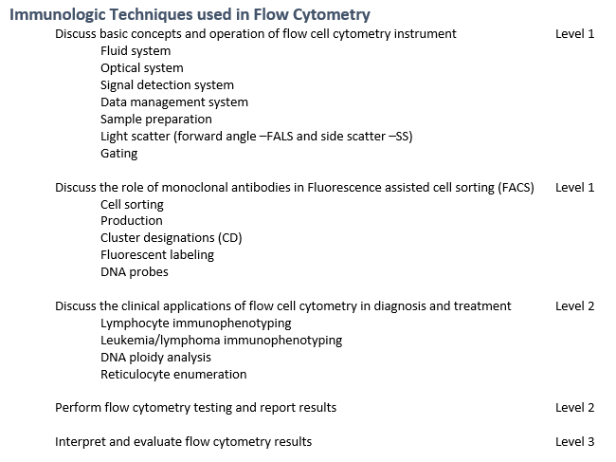
Medical Laboratory Science Curricular Requirements
ASCP MLS Content Guidelines (2021)
III. HEMATOLOGY LABORATORY TESTING
Flow Cytometry Immunophenotyping
Leukemia
Lymphoma
Lymphocyte subsets
PNH
ASCLS ELC (2016)
Adv. Hematology (2)
Clin. Immunology (1)
Notes:
FC is also listed by ASCP under Lab Operations in the MANUAL/AUTOMATED METHODOLOGY AND INSTRUMENTATION section (just listed among other techniques, such as spectrophotometry, electrophoresis, vaguely undefined “molecular methods” etc.

Slide 4
Flow Cytometry in Immunology
Task: lymphocyte subset analysis for assessment of the status HIV infection using MACSQuant Analyzer 10 (Miltenyi Biotec)

Slide 5
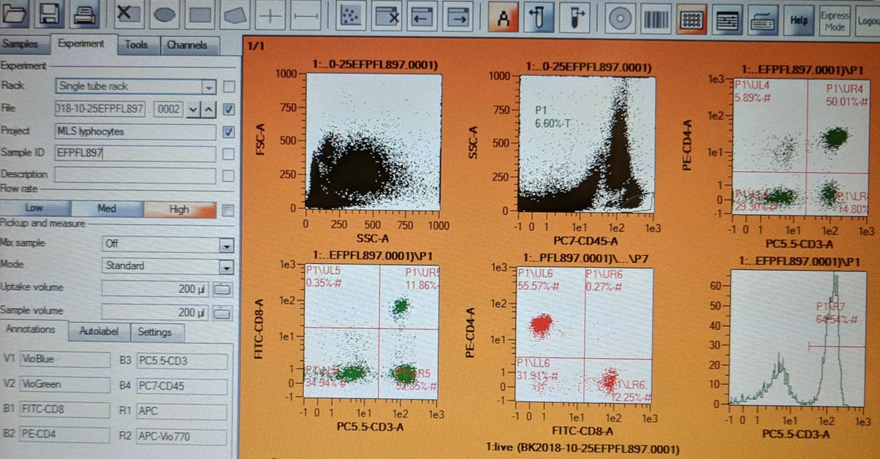
Flow Cytometry in Immunology
FC staining with conjugated antibodies: CD45-PC7, CD8-FITC, CD4-PE and CD3-PC5.5 (Beckman-Coulter Inc., Brea, CA), ODU IBC#18-021
Calculation of the CD4/CD8 ratio to categorize infection as active vs. under control
Notes:
De-ID samples, abs manufacturer, etc
Antobodies + labels used (manufacturer)
Patient samples and immunocontrol samples (normal and abnormal)

Slide 6
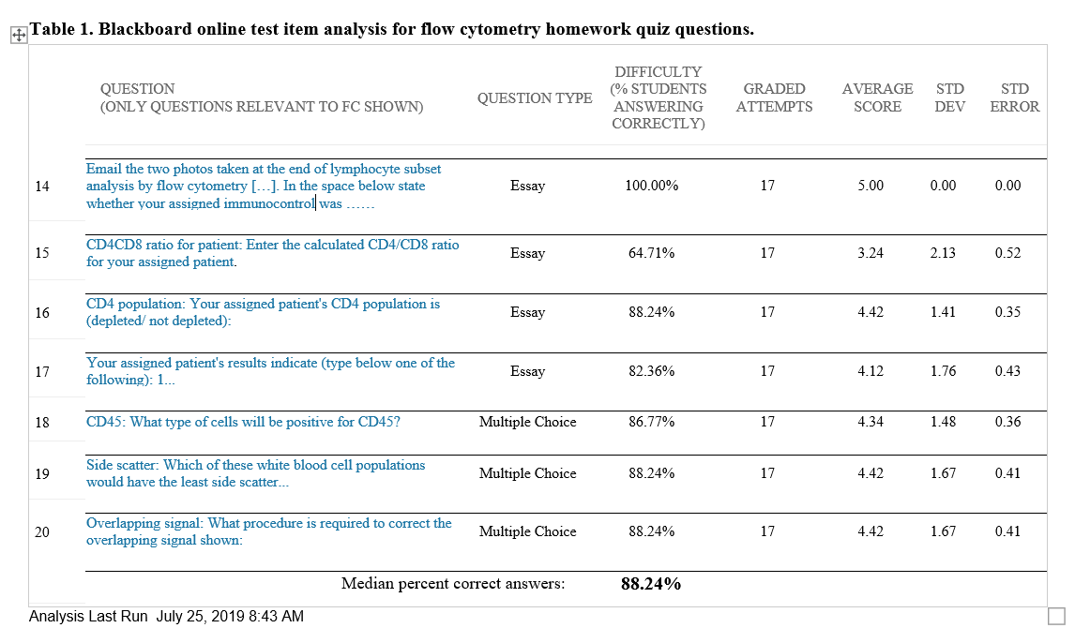
Immunology Didactic Assessment
Homework assignment: MC and open-ended questions
Final laboratory exam: 100 % correct
Notes:
Final: 2 out of 28 questions relevant to FC. All students interpreted the images/calculated ratios correctly.

Slide 7
Flow Cytometry in Advanced Hematology
Task: Immunophenotyping leukemia/lymphoma patients (BD Accuri C6 Plus)
Conjugated antibodies (Beckman-Coulter Inc., Brea, CA), ODU IBC#18-019
CD45- APC
CD8, Kappa light chains, CD8 – FITC
CD4, lambda light chains, CD33 – PE
CD3, CD19, CD34 – PC 5.5
B cell, T cell, and stem cell markers analyzed
Notes:
3 tubes total

Slide 8
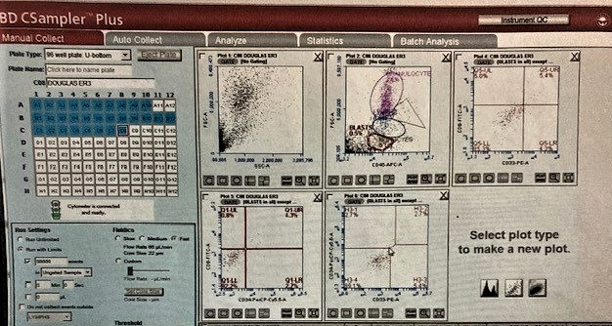
Advanced Hematology Didactic Assessment
Homework assignment: Open ended interpretation of scattergram + correlation to patient diagnosis
Results: Correct interpretation by 100 % of students

Slide 9
Post-didactic Assessment
Post graduation survey
Methodology
Qualtrics survey sent to 20 students
NVivo software to analyze qualitative data
IRB#: 1532870-6
Perceptions on effectiveness
Strengths/weaknesses
Effect of experience during didactic, clinical rotations, and employment

Slide 10
Survey Results
Response rate: 70% (14 out of 20)
Enhanced understanding of FC principles underlying lymphocyte subset analysis and leukemia/lymphoma immunophenotyping
Mixed reviews as to if it was relevant to clinical rotation
Undecided on if experiences prepared them for practice/ or made them more competitive in the job market
Notes:
Enhanced understanding: 91% in immunology, 100% in Advanced heme
Relevance to clinical rotation: 4 out of 14 could neither agree nor disagree
Preparation for practice/competitive in job market

Slide 11
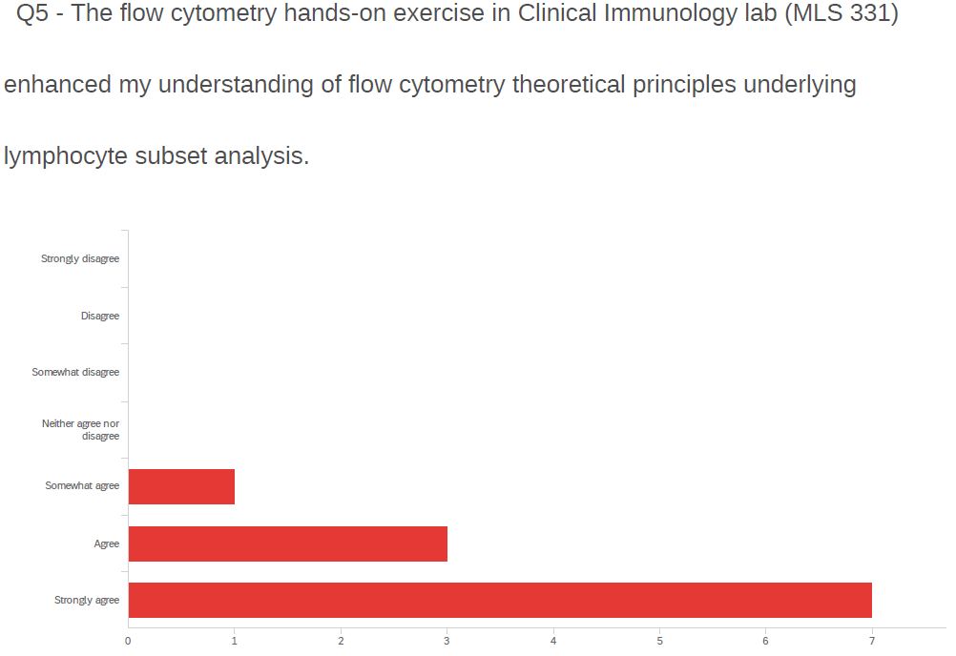
Survey Results
Results from Qualtrics survey, Question 5
Notes:
Split into 2 slides

Slide 12
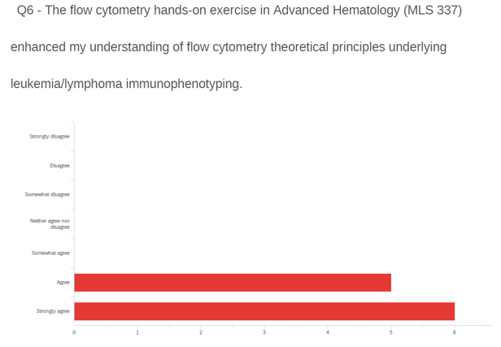
Survey Results
Results from Qualtrics survey, Question 6

Slide 13
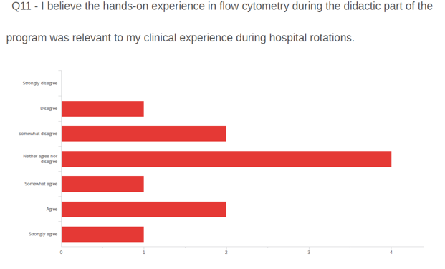
Survey Results
Results from Qualtrics survey, Question 11
Notes:
These results were expected: only 2 out of 13 clinical sites that offered hematology rotations during this time performed FC

Slide 14
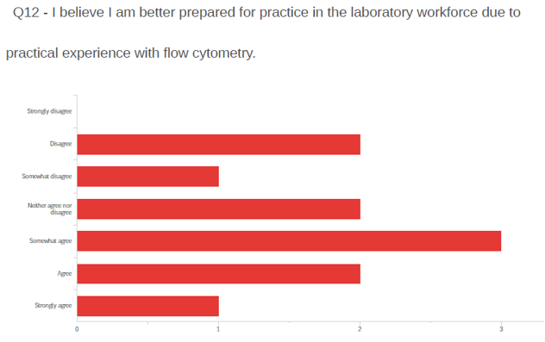
Survey Results
Results from Qualtrics survey, Question 12

Slide 15
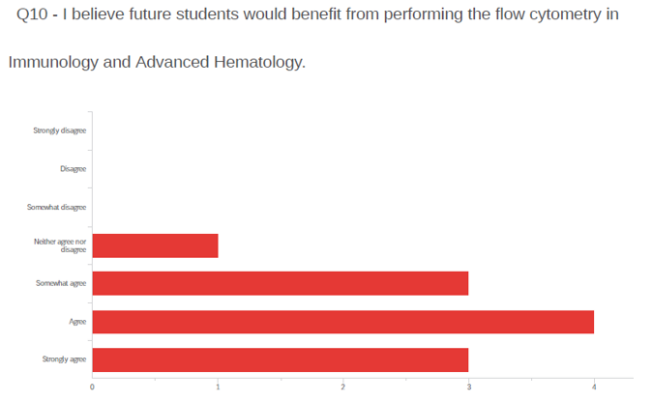
Survey Results
Results from Qualtrics survey, Question 10
Notes:
Reasoning for continuing to offer this experience

Slide 16
Survey Results
 | Time and Structure | Practical Skills | Benefits | Outcomes
Advantages | “Understand and interpret the graph and how that related to a patient’s disease” | “Hands-on aspect with practice” and “practical hands-on experience” | Helped students “think critically to learn patience and how to follow directions thoroughly” | experience “puts things into perspective”
 | Future students should have a “chance to participate in this too.” | “extremely helpful” and an "accumulation of many concepts learned” | learned “how to read the scatter plot” and “manually analyze and characterize the flow cytometry data” | “the most constructive in regards to my learning”
 | Enjoyed step by step approach to the preparation, testing, and analysis. | “correlate what was taught in class to the instruments in the lab” and “make everything [they] read actually stick.” | learned “principles behind the testing methodology" and “how to read the scatter plot | “Seeing how it benefited the healthcare field and the patients that treatment depended on it”
Disadvantages | Needed “more time and structure with the lecture portion,” | Performing “more than twice would’ve helped to further improve knowledge and experience.” | Suggestion of a "greater emphasis on the different flow cytometry data patterns"
 | was “too much,” and “only very basic information is needed” | “only relevant if you can specialize in flow”
Notes:
More advantages than disadvantages for each theme

Slide 17
Discussion
Most effective for didactic understanding
Provided experience they would not have gained in rotations or during employment
Continue to offer experience to future cohorts

Slide 18
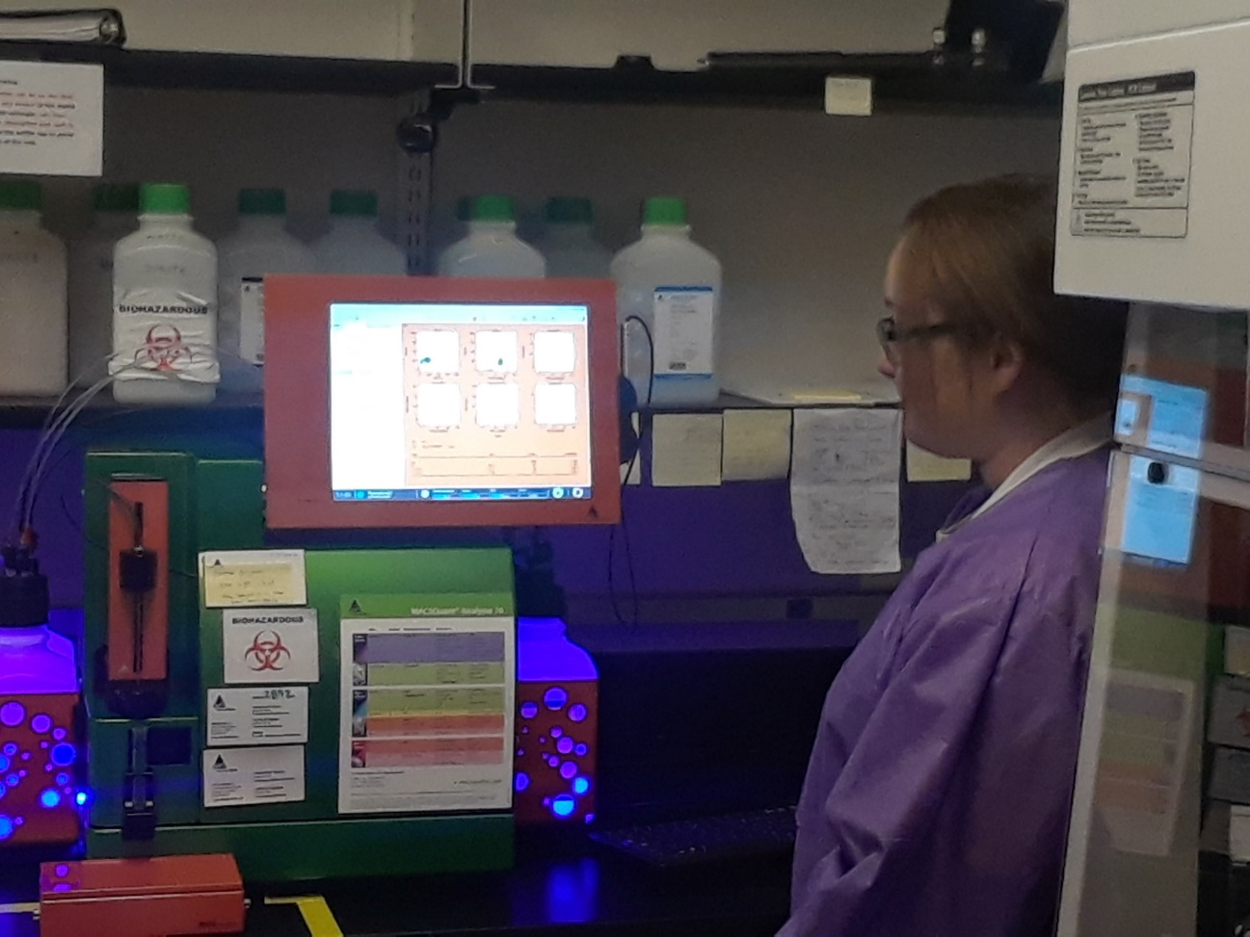
MACSQuant Analyzer 10
BD Accuri C6 Plus
Notes:
Why do we need this photo here??

Slide 19
Acknowledgements
American Society for Clinical Pathology Foundation Laboratory Science Program Director Educational Grant
Cristina Ruffy, MT(AMT), BB(ASCP)
Leslie Hoglund, PhD, MCHES®
Yu Jing, PhD, at Frank Riedy Research Center for Bioelectrics Flow Cytometry Core Facility/ Innovative Research Park
Mittal Patel, MLS(ASCP), Flow Cytometry/PCR Lab manager at Portsmouth Naval Medical Center
Gordon Ward

Slide 20
References
American Society for Clinical Laboratory Science (2016). Entry Level Curriculum for Medical Laboratory Science. ASCLS Press.
American Society for Clinical Pathology (July 2021). MLS Exam Content Guidelines. Available at https://www.ascp.org/content/docs/default-source/boc-pdfs/boc-us-guidelines/mls_content_guideline.pdf?sfvrsn=6. Accessed 5/23/2022.
CDC. 2003 guidelines for Performing Single-Platform Absolute CD4+ T-Cell Determinations with CD45 Gating for Persons Infected with Human Immunodeficiency Virus. MMWR 2003;52 (No. RR02); 1-13
Childs, R., Ruffy, C., Kraj, B., Hoglund, L. (2022). Integrating Flow Cytometry Immunophenotyping as a Teaching Tool for MLS Curriculum. American Society for Clinical Laboratory Science. Aug 2022 (pending).
Kraj, B.J., & Ruffy, C. (2019). Flow Cytometry Psychomotor Exercise in Medical Laboratory Science Curriculum Facilitates Correct Interpretation of Lymphocyte Subset Analysis. American Journal of Clinical Pathology, 152 (1). P.101
Nadder, T.S. & Davis, D. (2011). CLS Entry Level Competencies in Flow Cytometry. Clinical Laboratory Science, 24(1), 29-34.

