Slide 1
Integrating Foundational and Clinical Courses – A Thematic and Process Description Julie A. Kerry, Ph.D.

Slide 2
CareForward Curriculum 2.0
Shorten preclerkship phase from 2yrs to 18mo
Earlier start to clerkships
Increase time for Elective Phase of Curriculum
Changes to preclerkship courses…

Slide 3
Slide courtesy of Dr. Mily Kannarkat

Slide 4
Goal
Create a new course: Foundations of Disease
Foundational Science
Biochemistry, Molecular Biology, Histology, Cell Physiology, Immunology
General Mechanisms of Disease
Core concepts in Pathology and Introduction to Clinical Medicine
GI System and Metabolism
Metabolic Disorders and Nutrition

Slide 5
Guiding Principle – Cognitive Integration
Mode of acquiring, connecting and retrieving knowledge for application to a new problem
Linking of basic science and clinical knowledge
Basic science provides the connections to clinical signs and symptoms
Essential to develop clinical reasoning skills
Improves diagnostic accuracy in learners
Increases understanding of importance of key clinical features
Occurs in the learner but can be enhanced by curricular strategies

Slide 6
Guiding Principle – Cognitive Integration
Foundations of Disease
Align content
Link Foundational Science content to clinical signs and symptoms
Facilitate ability of students to recall information in a contextually meaningful way

Slide 7
Process – Inspiration: Nominal Group Technique
Julie A. Kerry, David Taylor-Fishwick, Frank Castora, Eva Forgacs, Samuel Ikonne and Scott Vergano

Slide 8
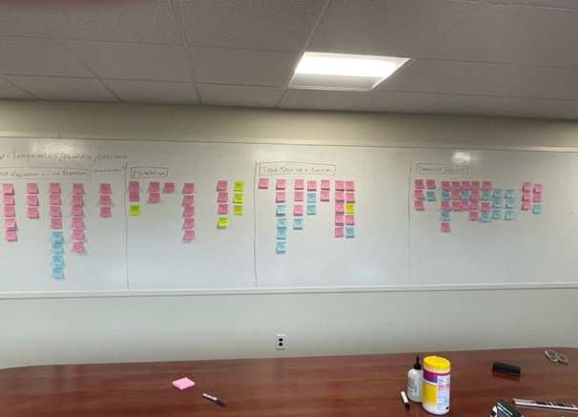
The Results!
Foundational Science adjacent to corresponding clinical and pathological content
Molecular Biology – Genetics and Genetic Disorders
Biochemistry – Metabolic Disorders
Immunology – Infectious Disease, Autoimmunity and Immunodeficiency

Slide 9
Pedagogy
Foundational Science
Open-ended questions to facilitate critical thinking
General Mechanisms of Disease
Open-ended questions to introduce clinical reasoning

Slide 10
Pedagogy
Foundational Science
Content self-contained within module
Short online learning units, concept maps, simple illness scripts
General Mechanisms of Disease
Expectation of more independent learning
Guidelines for independent learning, concept map frameworks, illness script activities

Slide 11
Outcomes to be Tracked
Student performance on assessments
Student evaluations
Focus groups
Students taking class for first time + Former Medical Master’s students

Slide 12
References
Kulamakan Kulasegaram, Julian C Manzone, Cheryl Ku, Aimee Skye, Veronica Wadey, Nicole N Woods Cause and Effect: Testing a Mechanism and Method for the Cognitive Integration of Basic Science Acad Med 2015 90(11 Suppl):S63-9
Alison Dobbie, Martin Rhodes, James W. Tysinger, Joshua Freeman Using a Modified Nominal Group Technique As a Curriculum Evaluation Tool FamMed 2004;36(6):402-6

Slide 13
Questions?

