Slide 1
ALLIED DENTAL STUDENTS’ DVI LEARNING OUTCOMES FOLLOWING A MULTIMEDIA MODULE
SAMANTHA VEST, MSDH
BRENDA BRADSHAW, MSDH
MARSHA VOELKER, BSDH
ANN BRUHN, MSDH
TARA NEWCOMB, MSDH
SINJINI SIKDAR, PHD

Slide 2
PROBLEM
Current literature lacks research on the effects of DVI learning interventions on cognitive and affective learning outcomes for allied dental professionals.

Slide 3
HYPOTHESES
Senior level dental hygiene and dental assistant students will be able to accurately match at least 4 out of 5 AM and PM dental radiographic sets.
There will be an increase of DVI match performance for dental hygiene students compared to dental assistant students.
Participants will indicate an increase in perceived DVI knowledge upon completion of the multimedia learning experience.
The participants will have an increase perception of the importance for their respective profession to volunteer in DVI after completing the learning experience.

Slide 4
METHODS
Descriptive pre and posttest intervention study
Qualtrics Surveys
3-point Likert-scale questions
Cognitive knowledge of forensic odontology
Cognitive knowledge of DVI
Affective attitude regarding importance of professional involvement
Multimedia learning experience intervention
Post Survey Radiographic Comparison Match Assessment

Slide 6
RADIOGRAPHIC COMPARISON MATCH ASSESSMENT

Slide 7
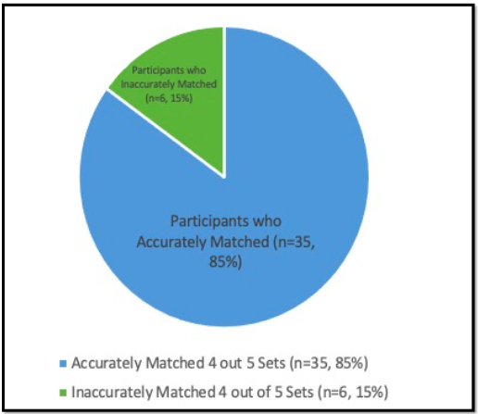
RESULTS
Demographics:
Majority female, white, and between the ages of 18-22 years old
85.4% response rate
Match Accuracy (Hypothesis #1)
Accurately matched 5 out of 5 sets: (n=35, 85%)
Statistically significant (p<0.05)

Slide 8
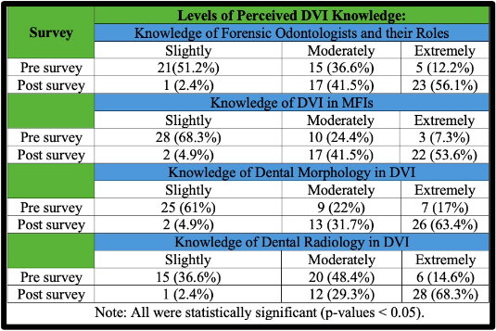
RESULTS
Match Performance by Discipline (Hypothesis #2)
Dental hygiene: (n=26, 99.96%)
Dental assistant: (n=9, 55%)
Fisher’s Exact Test: statistically significant (p<0.05)
Pre-Posttest Increase of Perceived Knowledge (Hypothesis #3)
One-sided greater than type linear trend test
Statistically Significant (p-value<0.0001)

Slide 9
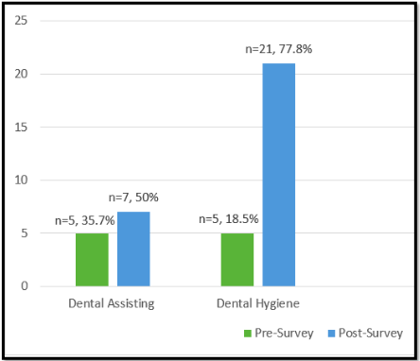
RESULTS
Perception of Professional Importance for DVI Volunteerism (Hypothesis #4)
Dental hygiene: pretest (18.5%); posttest (77.8%)
Dental assistant: pretest (35.7%); posttest (50%)
Statistically significant (p<0.05)

Slide 10
CONCLUSION
Dental hygiene and dental assistant students were able to apply foundational knowledge for transferable DVI skills.
Allied dental students possess radiographic comparison skills which can aid in DVI.
A DVI multimedia learning experience can increase learning outcomes for allied dental students.
Higher perception of importance for future volunteerism in DVI

Slide 11
THANK YOU! QUESTIONS???

