Slide 1

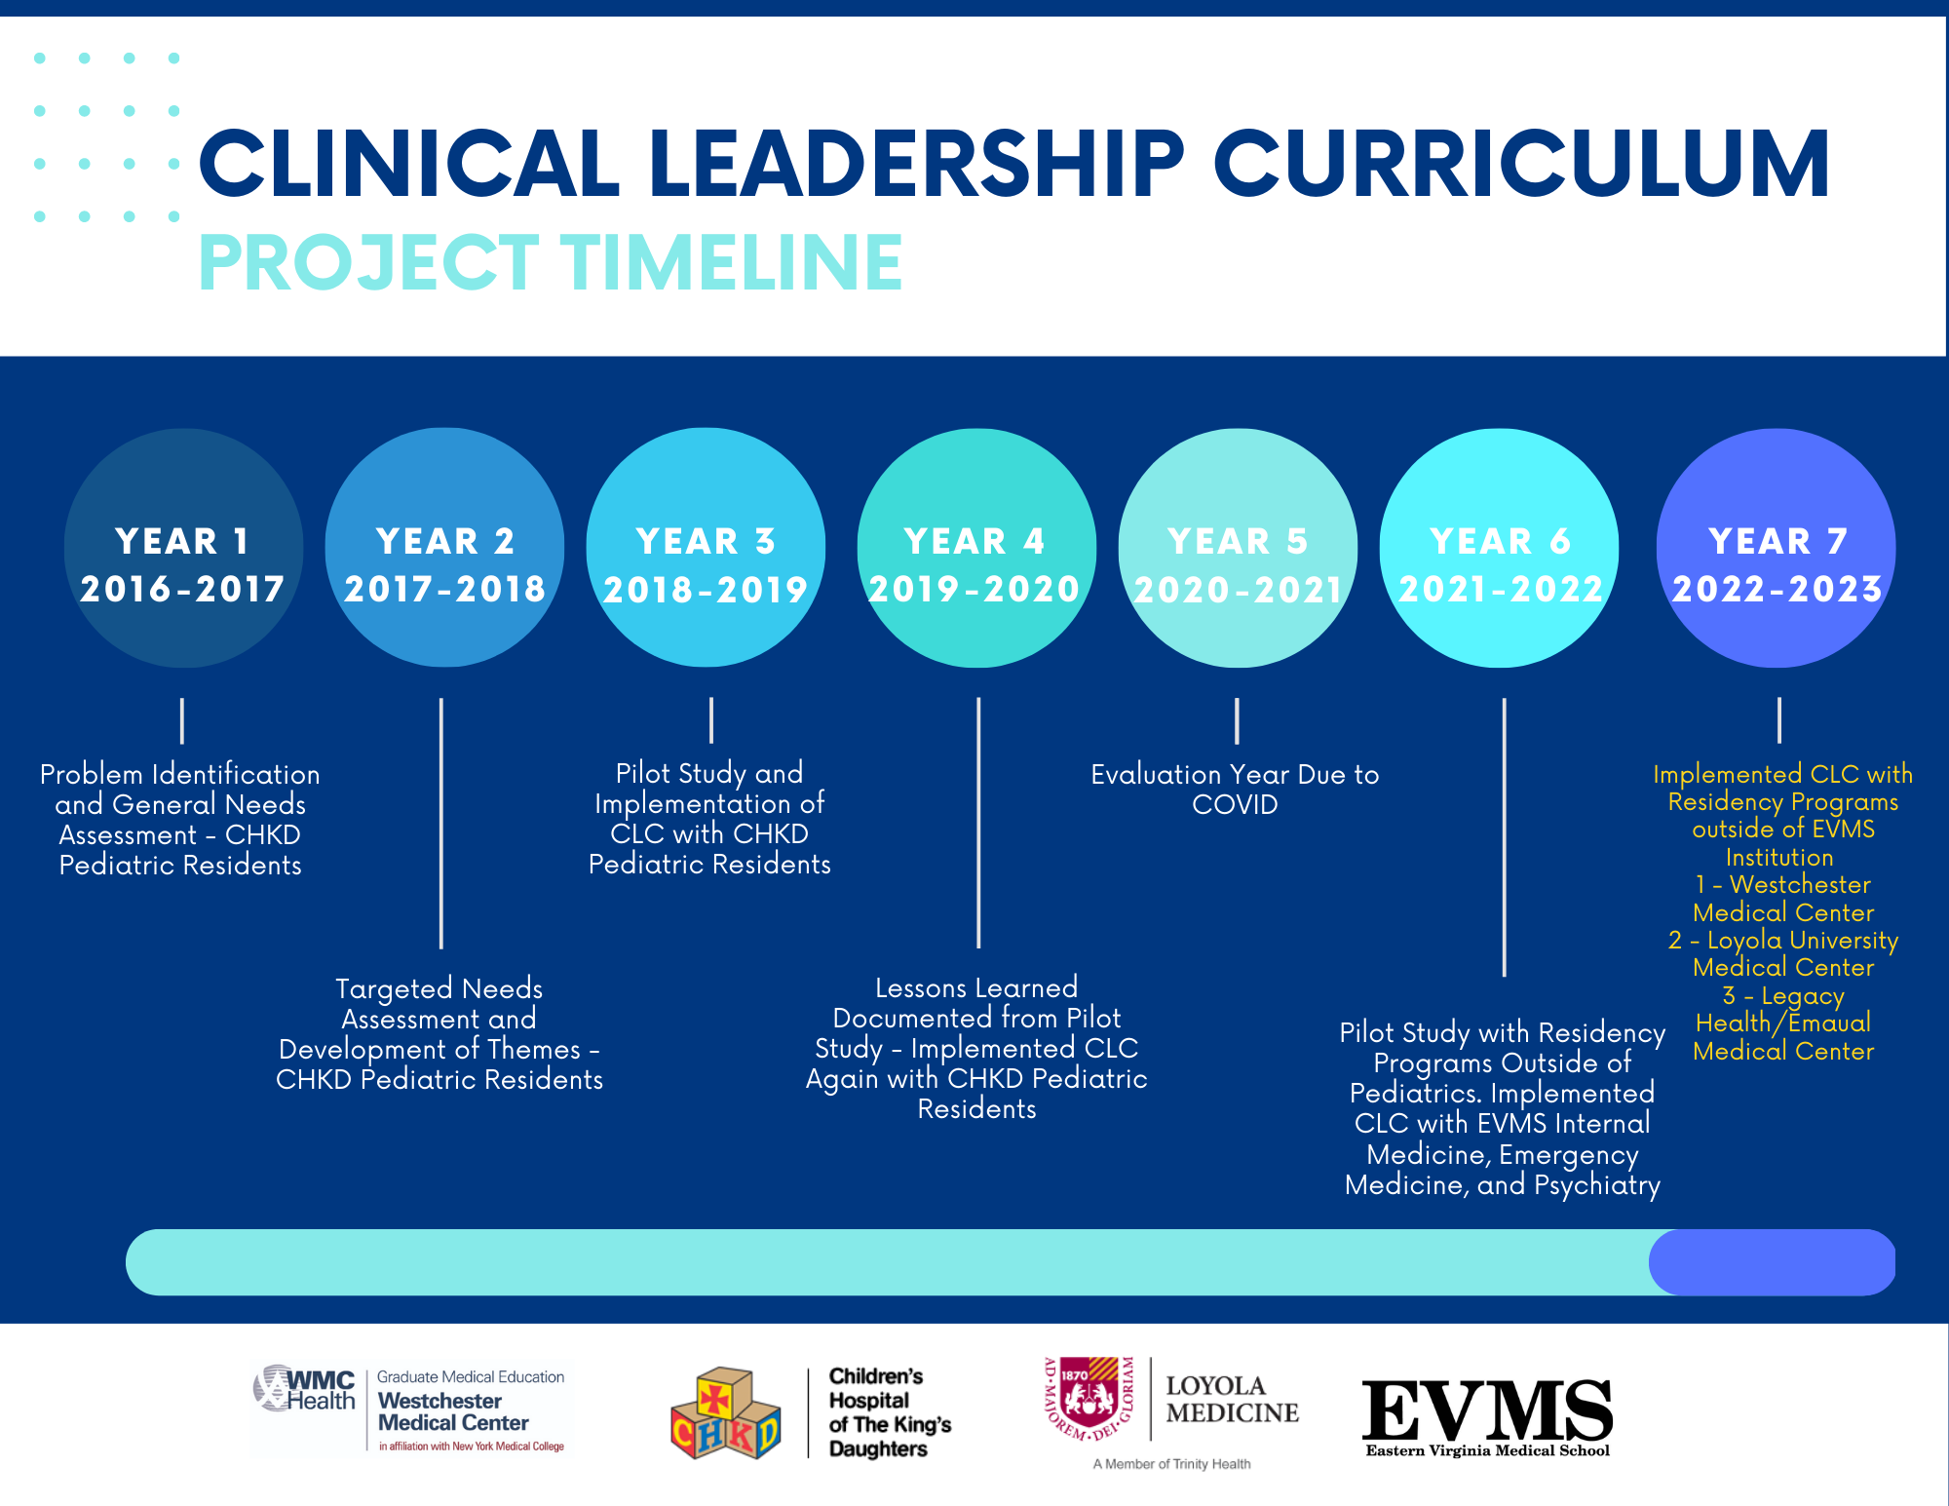
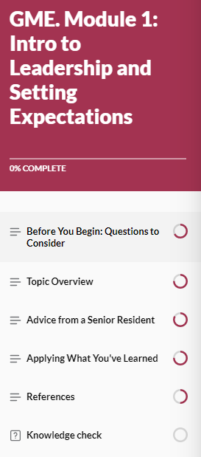
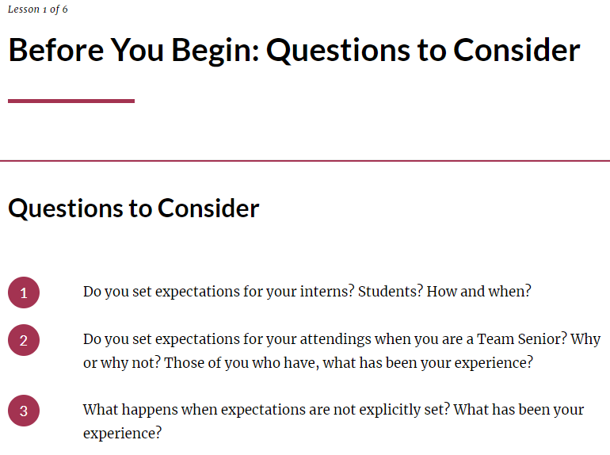
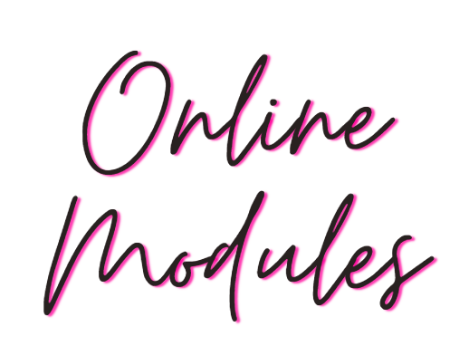
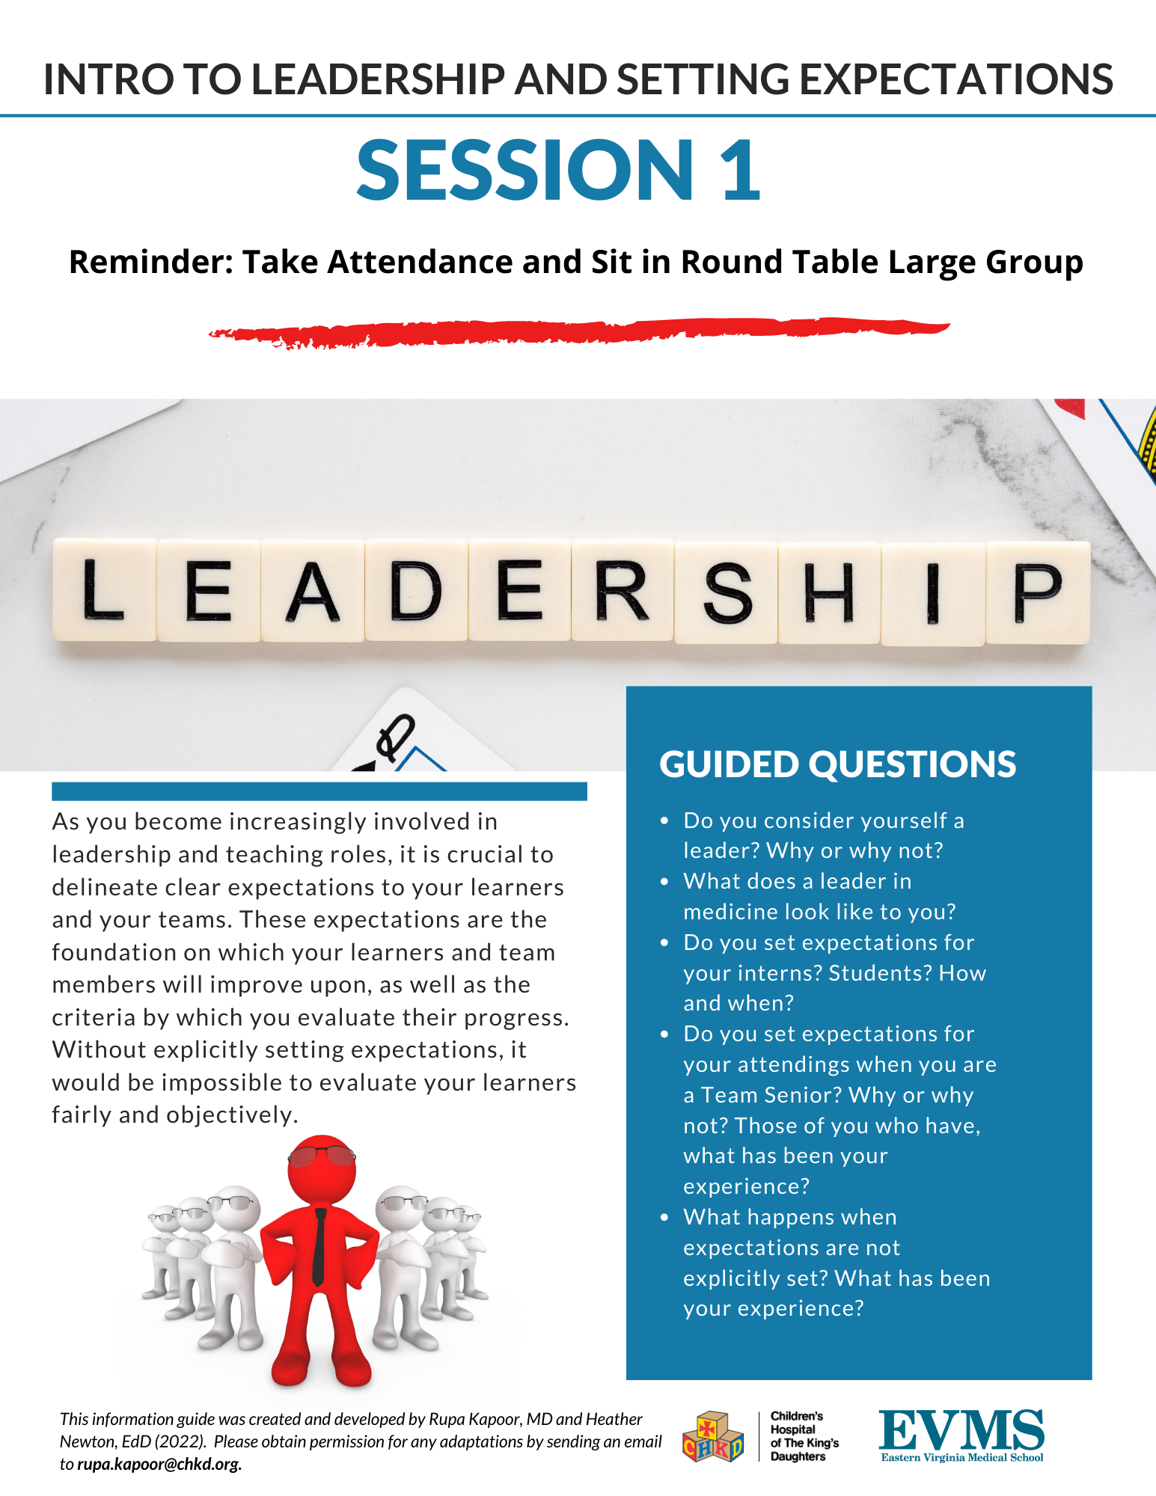
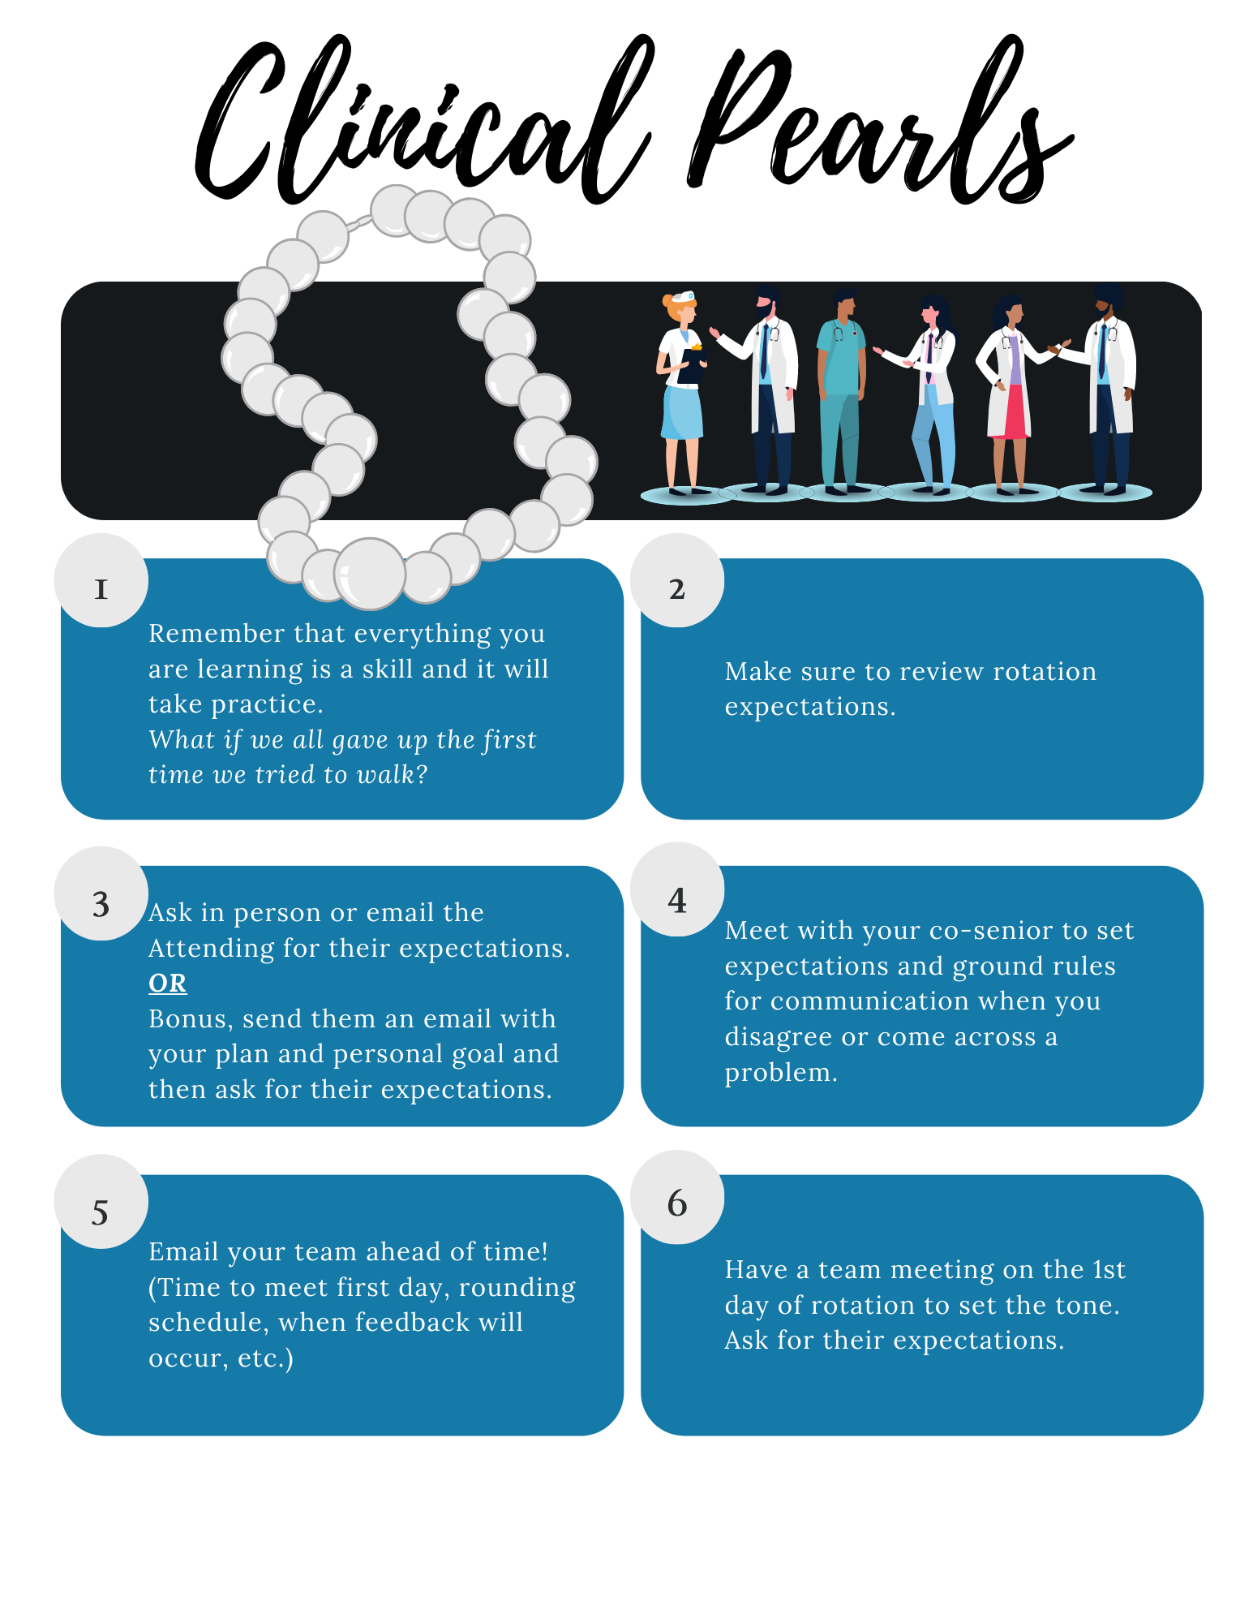
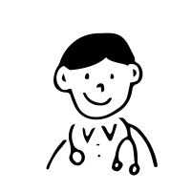
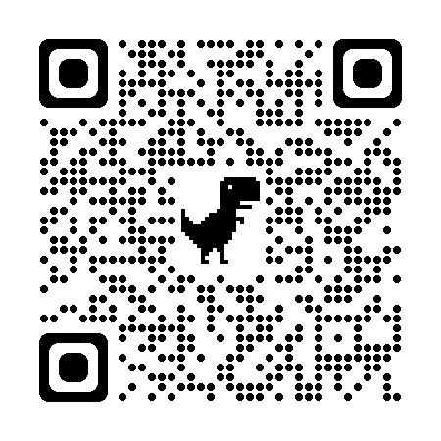
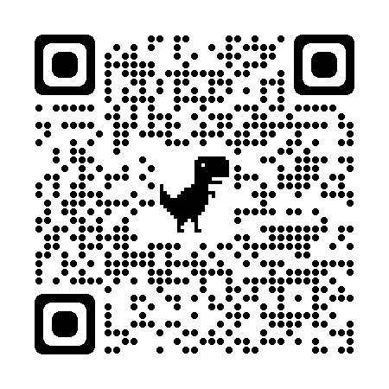
Collaboration and Customization of a Clinical Leadership Curriculum (CLC)
Across Specialties and Institutions
Eastern Virginia Medical School
(Virginia)
Westchester
Medical Center
(New York)
Hemasree Yeluru – Eastern Virginia Medical School (M3)
Heather Newton, EdD – Eastern Virginia Medical School (Graduate Medical Education)
Julia Keltz, MD – Westchester Medical Center (OB/GYN)
Marian Acevedo-Alvarez, MD – Loyola University Medical Center (OB/GYN)
Anya Cipi, MD – Eastern Virginia Medical School (Emergency Medicine)
Christina Gates, MD – Eastern Virginia Medical School (Emergency Medicine)
Shriti Patel, MD – Eastern Virginia Medical School (Psychiatry)
Abbey Mclean, MD – Eastern Virginia Medical School (Psychiatry)
Angie Xi, DO – Legacy Health, Emanual Medical Center (Internal Medicine)
Allison Abraham, MD - Legacy Health, Emanual Medical Center (Internal Medicine)
Rupa Kapoor, MD – Children’s Hospital of the King’s Daughters and Eastern Virginia Medical School (Pediatrics)
Legacy Health
Emanual Medical Center
(Oregon)
Loyola University
Medical Center
(Illinois)
Background
In 2016, a comprehensive needs assessment was conducted at Eastern Virginia Medical School (EVMS) to better understand the leadership training needs of pediatric residents. Those findings were consistent with and built upon, previously published quantitative and qualitative leadership training needs assessments. Through surveys, focus groups, and several iterations of development, a complete 10-month clinical leadership curriculum (CLC) was successfully created and implemented with the EVMS pediatric residency program. The CLC was then piloted within EVMS and shared with specialties outside of Pediatrics to include Internal Medicine, Emergency Medicine, and Psychiatry. This past academic year (2022-2023), the CLC was expanded to three external institutions across the United States and a new specialty, OB/GYN.
Clinical Leadership Curriculum (CLC) spreads between institutions and program specialties.
methods
1
2
3
5
4
EVMS and CHKD published 2 manuscripts (January 2021 and May 2022)
Three institutions then reached out to EVMS and CHKD to collaborate and discuss ways to implement the CLC within their programs
Zoom calls were set up and virtual meetings with the new institutions were scheduled
Piloted the CLC with new specialties and institutions concurrently – customized as needed
Conducted 90-minute facilitator trainings with program faculty at each institution
Results
SAMPLE:
Legacy Health – Emanual Medical Center
Facilitator Guide and Evidence-based Research
Samples
References

